Slide 2
Segment Roulette:
Don’t Gamble with Your Chart—Go Dimensional!

Slide 3

Introduction
Samantha Vislay
Senior GP Support Consultant
Work for Enavate

Slide 4
Who this presentation is for?
Companies currently using Microsoft Dynamics GP and considering a move to Business Central (BC).
Teams who want to understand how their existing GP framework translates into BC and why it isn’t a one‑to‑one transition.
Users who have reviewed BC before and felt overwhelmed by dimensions or how they fit into reporting.

Slide 5
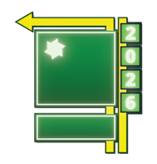
Agenda
Map GP to BC
How to translate your existing GP chart of accounts into Business Central’s structure
Establish Consistent Rules
Best practices to avoid inconsistent setups that lead to unreliable reporting
Understand BC’s Reporting Model
How BC’s dimensional structure influences reporting and analytics

Slide 6
Reframe your thinking
“The greatest danger in times of turbulence, is not the turbulence, it’s acting with yesterday’s logic”
~Peter Drucker
Notes:
It’s about adapting your thinking to take advantage of new features.
Moving Dynamics GP to Business Central often feels like losing something familiar.
The goal is not to recreate GP exactly. It is to adapt the structure to gain flexibility and better reporting.

Slide 7
Understanding the Core Structures
Chart of Accounts

Slide 8
GP Chart of Accounts Structure
Segments drive both posting AND reporting
Every new combination creates a new GL account
Over time this creates large and rigid charts of accounts
Segment | Meaning
000 | Revenue
1100 | Department
00 | Location
000-1100-00
Notes:
Reporting tied directly to segment position
Problems we have seen in the past:
If you add a new segment then you need to complete an entire project to update your Chart of Accounts.
If you add a new account and it doesn’t already exist then you need to manually add the account for the system to report to it.
These make changing COA structure later to be a painful and costly process.

Slide 9
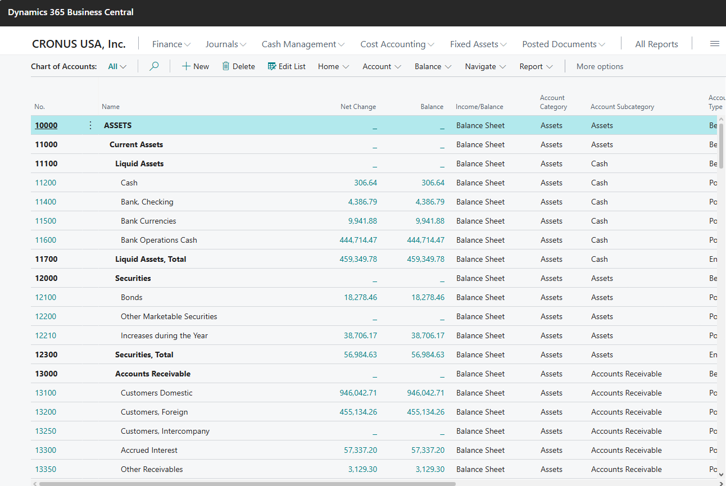
BC Chart of Accounts Structure
BC only has one account segment which is the main account

Slide 10
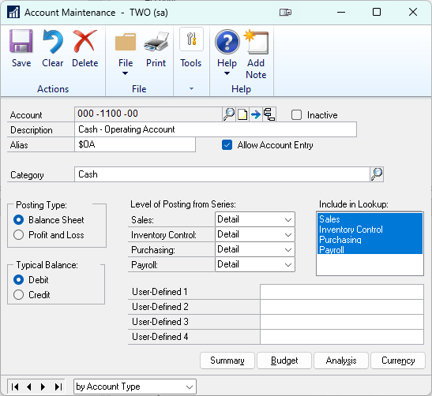
Comparison
GP | BC
000-1100-00 | 1100

Slide 11
Chart of Accounts Design Rules
Keep the chart of accounts simple
1
Avoid rebuilding GP segments in BC
2
Use dimensions for analysis
3

Slide 12
Designing your chart of accounts
Posting
Begin-Total
End-Total
Notes:
Posting (journals can post lines to these accounts)
Heading (defines an overall heading in the chart of accounts)
Total (defines a formula for a subtotal in the chart of accounts)
Begin-Total (defines a beginning heading for a subtotal in the chart of accounts. All subsequent lines until an End-Total line are indented)
End-Total (defines an ending heading for a subtotal and the formula for it in the chart of accounts. All subsequent lines after this End-Total line are outdented)

Slide 13
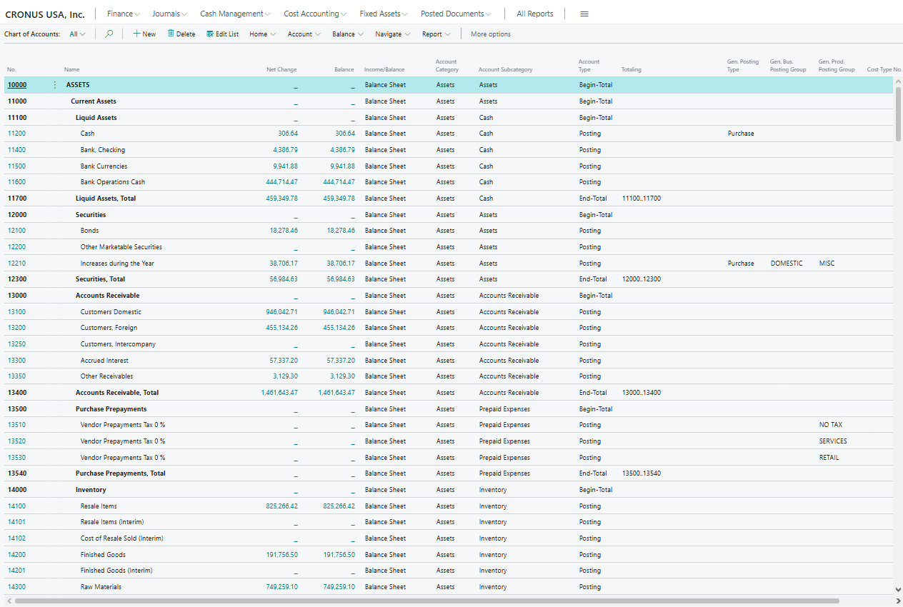
Example
Notes:
Default Balance statement in COA.
Groups of 50 between groupings to have room to grow.

Slide 14
Understanding the Core Structures
Segments into Dimensions

Slide 15
Business Central Dimensions
Replace segmented account structures.
Offering 2 Global Dimensions and up to 6 additional Shortcut Dimensions.
Categorize transactions without adding accounts
Enable flexible reporting
Add meaning beyond the chart of accounts as an attribute of a line item
Notes:
“The same expense account, but reported by department, location, or project”

Slide 16
Global Dimensions
Two dimensions designated as “Global”
Stored directly on every ledger entry
Available in filters, reports, and views
Designed for the most frequently used categories
Notes:
Because they are stored directly in the core ledger tables, Global Dimensions are the fastest and most efficient for reporting. They should represent the most commonly filtered business attributes.
Organizations usually select dimensions that represent their most common reporting views. For example, finance teams often analyze profitability by department or by business unit, making those strong candidates for global dimensions.

Slide 17
Shortcut Dimensions
Up to 6 additional Shortcut Dimensions available
Reporting needs are more detailed
Not stored directly on ledger tables
Used across transactions and journals on subset of data
Notes:
Shortcut Dimensions expand reporting beyond the two Global Dimensions while still allowing structured categorization.
While not stored directly on the ledger entry like Global Dimensions, they are still tied to transactions and fully available in reporting.
Examples
Project
Sales Region
Product Line
Program
Campaign

Slide 18
Grey area for classification
Question | Likely Choice
Will this be used in almost every transaction? | Global Dimension
Is it critical for financial reporting? | Global Dimension
Is it used only by specific teams or processes? | Shortcut Dimension
Could the list of values grow significantly over time? | Shortcut Dimension
Sales region can possibly be for Global or shortcut
It can depend on how your Subledgers flow
Best practice is not to use all 8
Notes:
It is how your organization is utilizing it and how your organization is organized.
Grey areas = Flexibility
QuestionLikely ChoiceWill this be used in almost every transaction?Global DimensionIs it critical for financial reporting?Global DimensionIs it used only by specific teams or processes?Shortcut DimensionCould the list of values grow significantly over time?Shortcut Dimension

Slide 19
Dimension Best Practices
Standardized Dimension Values
Use a consistent set of approved values.
Required Dimensions
Ensure key dimensions are mandatory where needed.
Clear Naming & Governance
Maintain consistent naming and usage rules.
Reliable Reporting Structure
Well-managed dimensions produce accurate reporting.
Notes:
Let’s now talk about best practices. You will want to create clear dimension rules.
As your organization, ask yourself:
First as which dimensions will exist?
Define clear dimension values
Avoid duplicate naming
Then ask yourself, when will they be used?
A. Document usage guidelines
An examples of a rule would be to have a defined dimension “Department” required for all expenses.
Another would be a “Project” value required for consulting revenue
BC reporting is not as powerful out of the box. Power BI and Solver will give more powerful reporting options.
After they are setup you will then proceed to train users on proper creation (as needed) and selection.

Slide 20
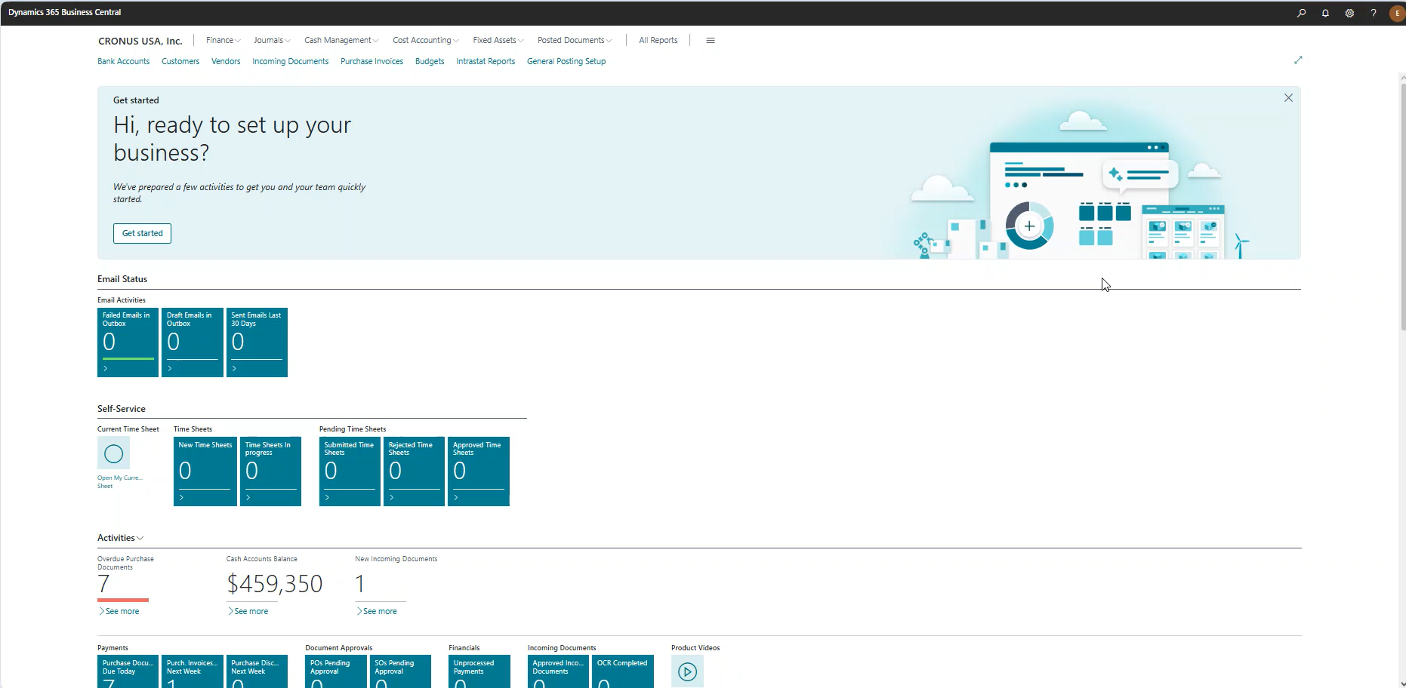
Demo

Slide 21
Understanding the Core Structures
Account Maintenance into Posting Groups

Slide 22
What are posting groups?
Automate G/L Posting
Connect Subledgers to the G/L
Ensure Consistent Financial Entries
Notes:
Posting groups act as the bridge between operational transactions and the general ledger. Instead of users selecting accounts manually, Business Central uses posting group setups to automatically determine where entries should post, ensuring consistency and reducing errors across purchasing, sales, inventory, and other modules.

Slide 23
Dynamics GP Posting Accounts
Class Setup
Maintenance Card Setup
General Posting Setup
Notes:
In GP we typically will set the default accounts in the Global Posting account.
We then have the option to setup accounts on the customer one at a time.
To apply different sets of accounts to different types of customer we will use Classes.

Slide 24
BC Posting Group Types
General Business Posting Group
General Product Posting Group
General Posting Setup
Identifies WHO you are doing business with (customer or vendor category).
Identifies WHAT is being sold or purchased (item, service, or resource category).
Combines the Business and Product groups to determine which G/L accounts are used for revenue, COGS, and purchases.
Notes:
Now that we have review GP let’s look at how BC handles posting groups. Think of posting groups as a two-key system that determines where financial entries go. The General Business Posting Group describes the type of customer or vendor, while the General Product Posting Group describes the type of item or service. Business Central then looks at the General Posting Setup table, where those two values intersect, to determine which general ledger accounts should be used during posting.
This is conceptually similar to Dynamics GP posting accounts, but Business Central separates the setup into who and what, giving organizations more flexibility and control over financial posting.

Slide 25
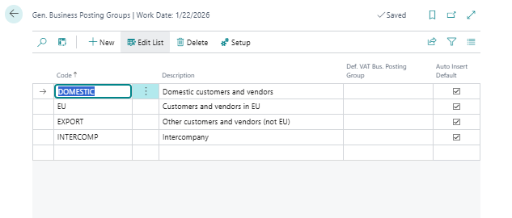
General Business Posting Group

Slide 26
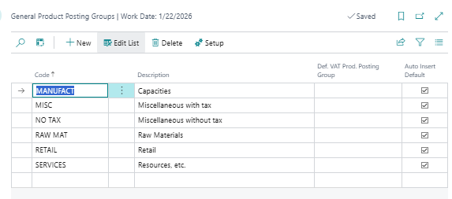
General Product Posting Group

Slide 27
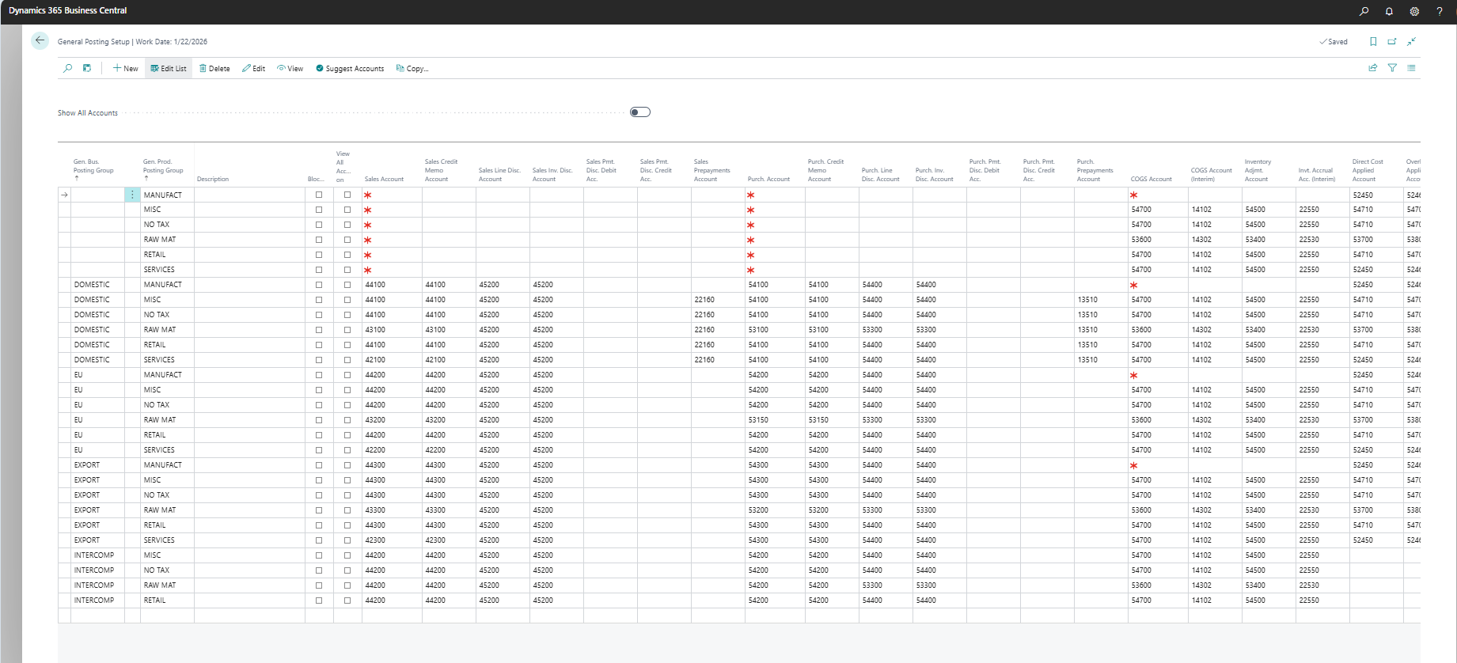
General Posting Setup

Slide 28
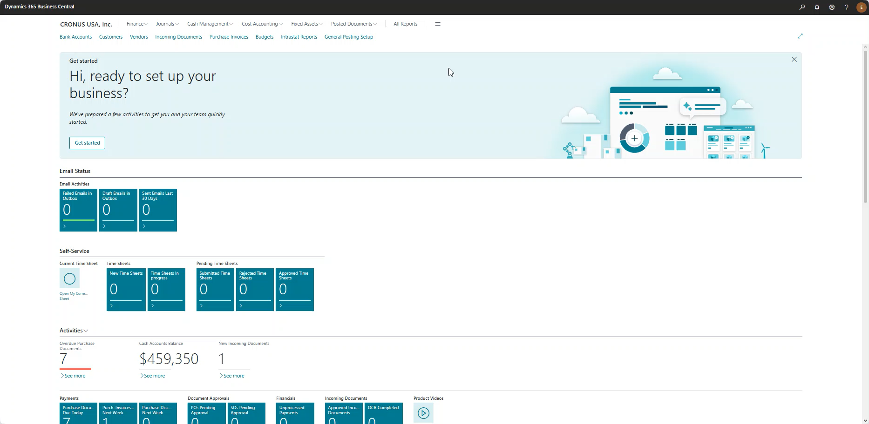
Demo

Slide 29
Specific Posting Groups
Customer Posting Groups
Vendor Posting Groups
Inventory Posting Groups
Bank Account Posting Groups
Fixed Assets Posting Groups
Notes:
Customer Posting Groups
Select the Customer Posting Groups window to define the Business and Product Posting Groups you utilize when posting receivables.
Vendor Posting Groups
Select the Vendor Posting Groups window to define the Business and Product Posting Groups you utilize when posting payables, service charges, or payment discounts.
Inventory Posting Groups
Select the Inventory Posting Groups window to define balance sheet inventory accounts and separate items by group.
Bank Account Posting Groups
Select the Bank Account Posting Groups window to define accounts for bank accounts so you can follow transactions.
Fixed Assets Posting Groups
Select the FA Posting Groups window to define accounts for each type of cost or expense.

Slide 30
Tax Posting Groups
Tax Business Posting Groups
Tax Product Posting Groups
Tax Posting Setup
Notes:
Tax Business Posting Groups
Select the Tax Business Posting Groups window to calculate sales tax for buyers and sellers based on each one’s geographical location and local regulations.
Tax Product Posting Groups
Select the Tax Product Posting Groups window to calculate sales tax for the products you buy and sell.
Tax Posting Setup
Select the Tax Posting Setup window to combine groups of businesses and products and thus relevant accounts.

Slide 31
Understanding the Core Structures
BC Reporting

Slide 32
BC Built In Report Options
Financial Reports (Financial Statements)
Data Analysis (SmartList Alternative)
Row/column definitions for flexible layouts
Power BI
List views that filter, sort, group, totals
KPI Dashboards
Built-in Reports (Operational Reports)
Aged Receivables/Payables
Trial Balance
Customer/Vendor reports
Interactive analytics
Ad-hoc analysis directly in lists
Custom financial reporting
(Income Statements, Balance Sheet, Statement of Cash Flow)
BC reporting combines built-in financials, flexible analysis, and extensible BI tools.
Notes:
In Business Central, dimensions provide the context for financial transactions. If they are not applied consistently, reports that rely on those dimensions will produce incomplete or misleading results.
Common issues include:
• Missing dimension values
• Multiple values representing the same concept
• Optional dimensions that should be required
• Inconsistent naming conventions
When this occurs, the data may technically exist in the ledger, but the reporting layer cannot group or interpret it correctly.
“Financial Reports tell you how the business is performing.
Built-in Reports show you what makes up those numbers.”
“Financial Reports are what you run.
Account Schedules are what you build.”

Slide 33
Example Scenario: Department Reporting
Management wants to analyze expenses by department.
The company has two departments:
Department | Dimension Value
Sales | SALES
Operations | OPS
Transactions:
Account | Amount | Department
Travel Expense | $2,000 | SALES
Travel Expense | $1,200 | OPS
Office Supplies | $800 | SALES

Slide 34
Example Scenario: Department Reporting
Report Output:
Department | Total Expenses
SALES | $2,800
OPS | $1,200

Slide 35
Example of Poor Dimension Usage
Now assume inconsistent setup occurs:
Account | Amount | Department
Travel Expense | $2,000 | SALES
Travel Expense | $1,200 | Ops
Office Supplies | $800 | (blank)
Travel Expense | $500 | Sales Dept
Report Output:
Department | Total Expenses
SALES | $2,000
Ops | $1,200
Sales Dept | $500
(Unassigned) | $800
Notes:
Problems introduced:
• Ops vs OPS – two different values
• Sales Dept vs SALES – inconsistent naming
• Blank dimension values – missing data
Why this happens:
Unlike GP segments, which are embedded into the account structure itself, BC dimensions are applied to transactions. If users apply them inconsistently—or not at all—reports cannot properly group the data.
This is why dimension governance is critical.

Slide 36
Final Takeaways
Don’t recreate your GP chart of accounts in BC
Use dimensions for analysis, not accounts
This is not a one-to-one translation.
Review your business workflows ….
Establish governance rules early
A well-structured system leads to better reporting and analytics

Slide 37


Resources
Dimensions: https://learn.microsoft.com/en-us/training/modules/dimensions-dynamics-365-business-central/
Posting Groups: https://learn.microsoft.com/en-us/training/modules/posting-groups-dynamics-365-business-central/

Slide 38

Feedback Is Appreciated
Before we wrap up, I’d really value any feedback you may have.
Examples:
  Areas that could be clearer?
  What didn’t work and what worked?

