Slide 1



DYNAMICS GP
Orlando, FL October 19-23, 2025

Slide 2

Advanced Changes to Word Templates in Dynamics GP
Samantha Vislay MCSE, MCSA GP Functional Consultant, Enavate

Slide 3
Agenda
Implement Advanced Formatting Techniques
Troubleshoot Common Template Issues
Best Practices for Managing Template Versions

Slide 4
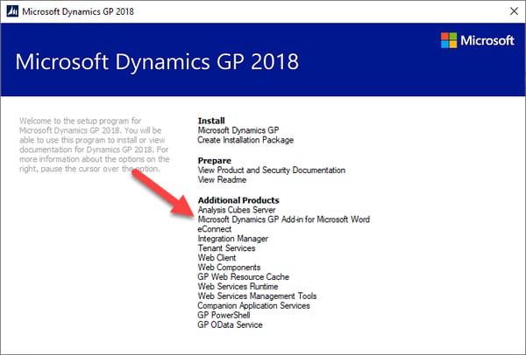
Prerequisites
Install from the Microsoft Dynamics GP Media.
This will install the add-in into Microsoft Word.

Slide 5
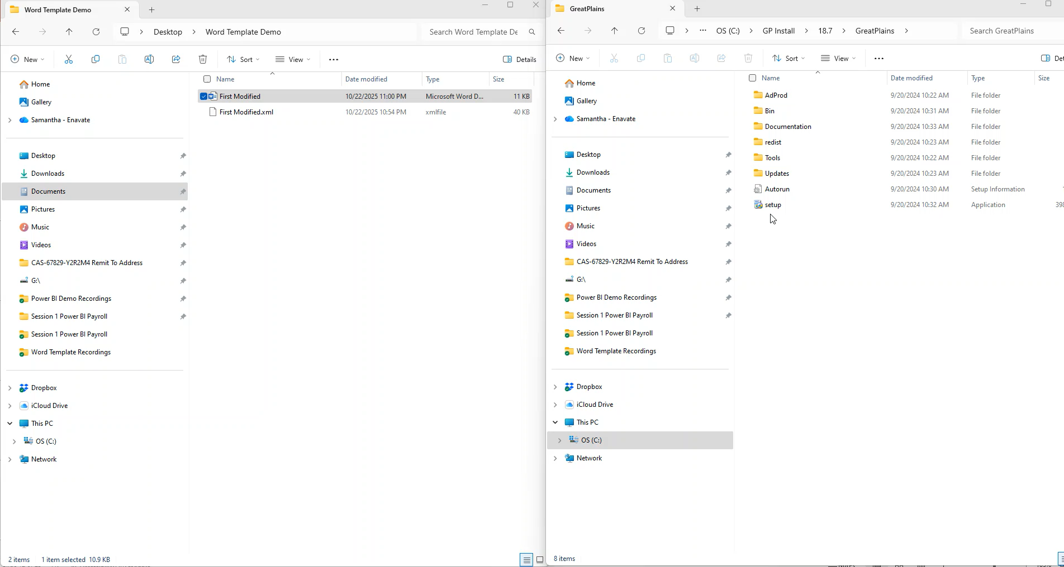
Install Word Add In & Turn On Settings

Slide 6
Standard Vs. Modified
Standard Templates
Delivered by Microsoft as default Word templates
Include basic fields and layouts for common documents
Serve as a foundation for customization
Modified Templates
Created when a standard template is copied and tailored
Allow insertion of custom fields, branding, and formatting changes
Support table modifications, alignment adjustments, and enhanced layouts
Notes:
Standard templates = starting point
Modified templates = customized to match your business needs

Slide 7

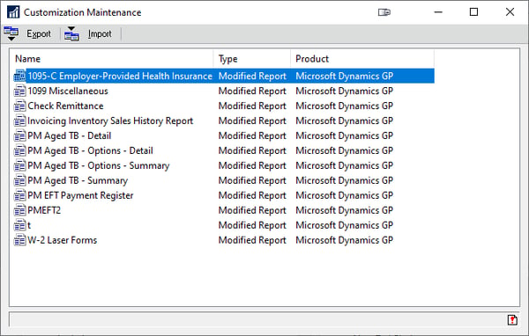
Determine if the report is modified
Another method to determine modified reports is to check the Customization Maintenance window.
To access this, go to:
Tools >>
Customize >>
Customization Maintenance
Notes:
If the report has a modification, it will display in the list; however, this does not indicate if the security is set up for users to print the modified report. Also, check the security in the Alternative/Modified Forms and Reports window.

Slide 8
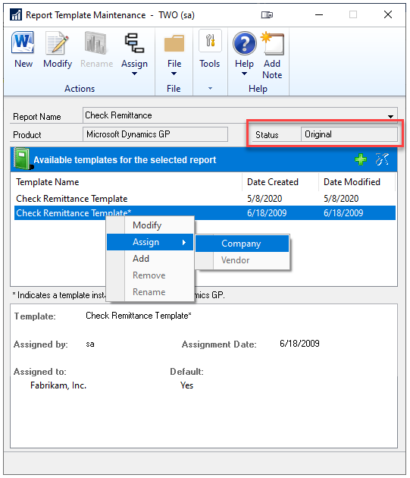
Modification Version In Word Templates
Once you determine which reports have a modification, you will then select the corresponding version within the Report Template Maintenance window.

Slide 9
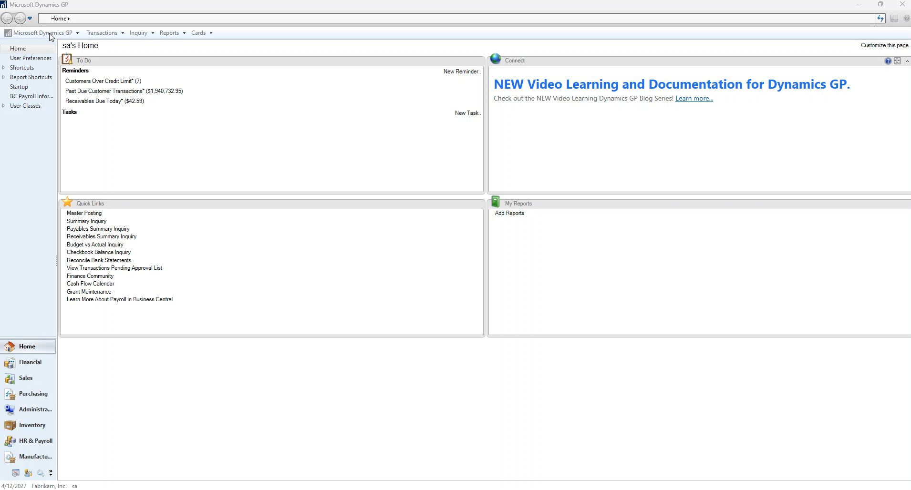
Demo: Identifying Standard vs. Modified
Notes:
The items I would like to note in this demo is that we are first going to the customization window as in the prior screen.

Slide 10
Exporting New Modified Template
Create XML
Then use utility to create starting point
Drag and Drop

Slide 11
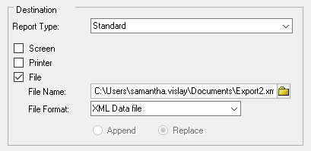
Printing the XML
Go through the process of generating the report in Dynamics GP.
In the selection panel:
Select File
Define a path in the file name
Select a path
Define the file format as an XML Data file
Notes:
To print the XML, you will go through the process of generating the report in Microsoft Dynamics GP. Then in the selection panel you will select File and then define a path in the file name. First select a path, then define the file format as an XML Data file. The destination should look like the following screenshot:

Slide 12
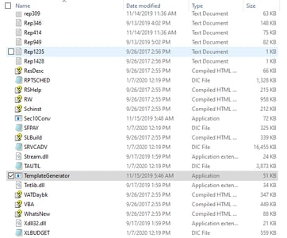
Word Forms from XML
Navigate to GP folder in Explorer
Path varies depending on GP version
The final folder will typically be the version that you are running. For example, if you are on GP2018, then the final folder will be GP2018.
C:\Program Files (x86)\Microsoft Dynamics\GP2018
In the folder, locate the Template Generator application
Notes:
Microsoft has created an easy way to turn the XML into a Word form with minimal effort. First, navigate to your Microsoft Dynamics GP folder in Explorer. A typical path, which can vary depending on your version of Microsoft Dynamics GP, is C:\Program Files (x86)\Microsoft Dynamics\GP2018. The final folder will typically be the version that you are running. For example, if you are on GP2018, then the final folder will be GP2018. Once in this folder, locate the TemplateGenerator application.

Slide 13
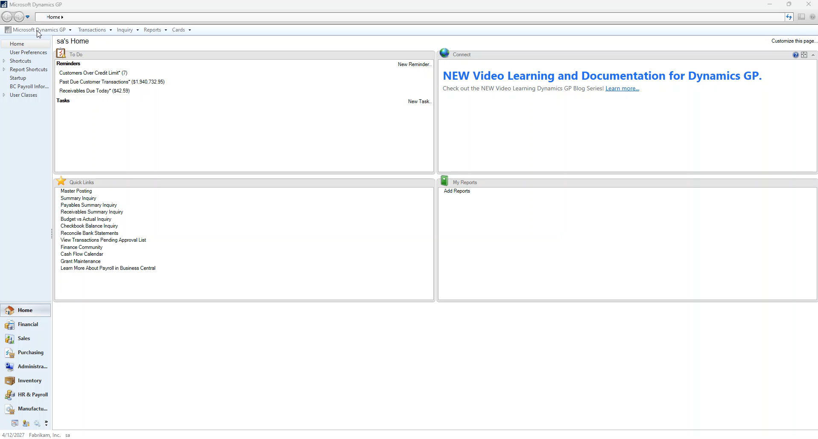
Creating an XML

Slide 14
Template Generator
The Template Generator automates the creation of Word Templates from Report Writer reports within Dynamics GP, saving time and reducing manual setup.
Converts standard GP reports into customizable Word templates.
Extracts report fields, layout, and formatting into a base .docx file.
Supports multiple report types (e.g., SOP, POP, and RM documents).
Ensures compatibility with existing security and report assignments.
Notes:
Always generate from a clean, unmodified Report Writer report.
Save templates to a shared directory for user access and version control.
Verify field mappings before modifying design elements.
Use Word’s Developer tab to view mapped fields and ensure correct data placement.

Slide 15
Best Practices
Always generate from a clean, unmodified Report Writer report.
Save templates to a shared directory for user access and version control.
Verify field mappings before modifying design elements.
Use Word’s Developer tab to view mapped fields and ensure correct data placement.

Slide 16
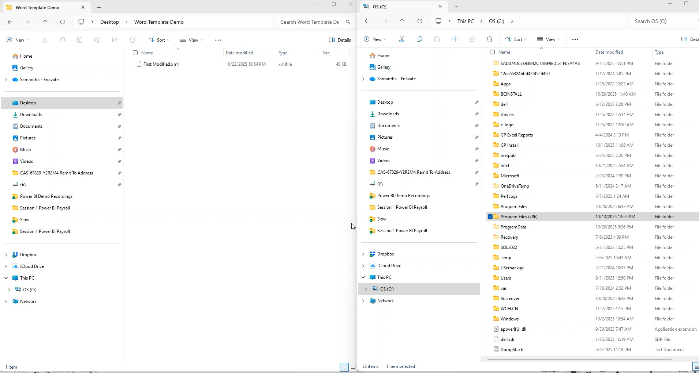
Demo Of Template Generator

Slide 17
Modifying Modified Template
If a template already exists and you are adding a new field:
Modify in Report Writer and then export XML
Open Word template and import

Slide 18
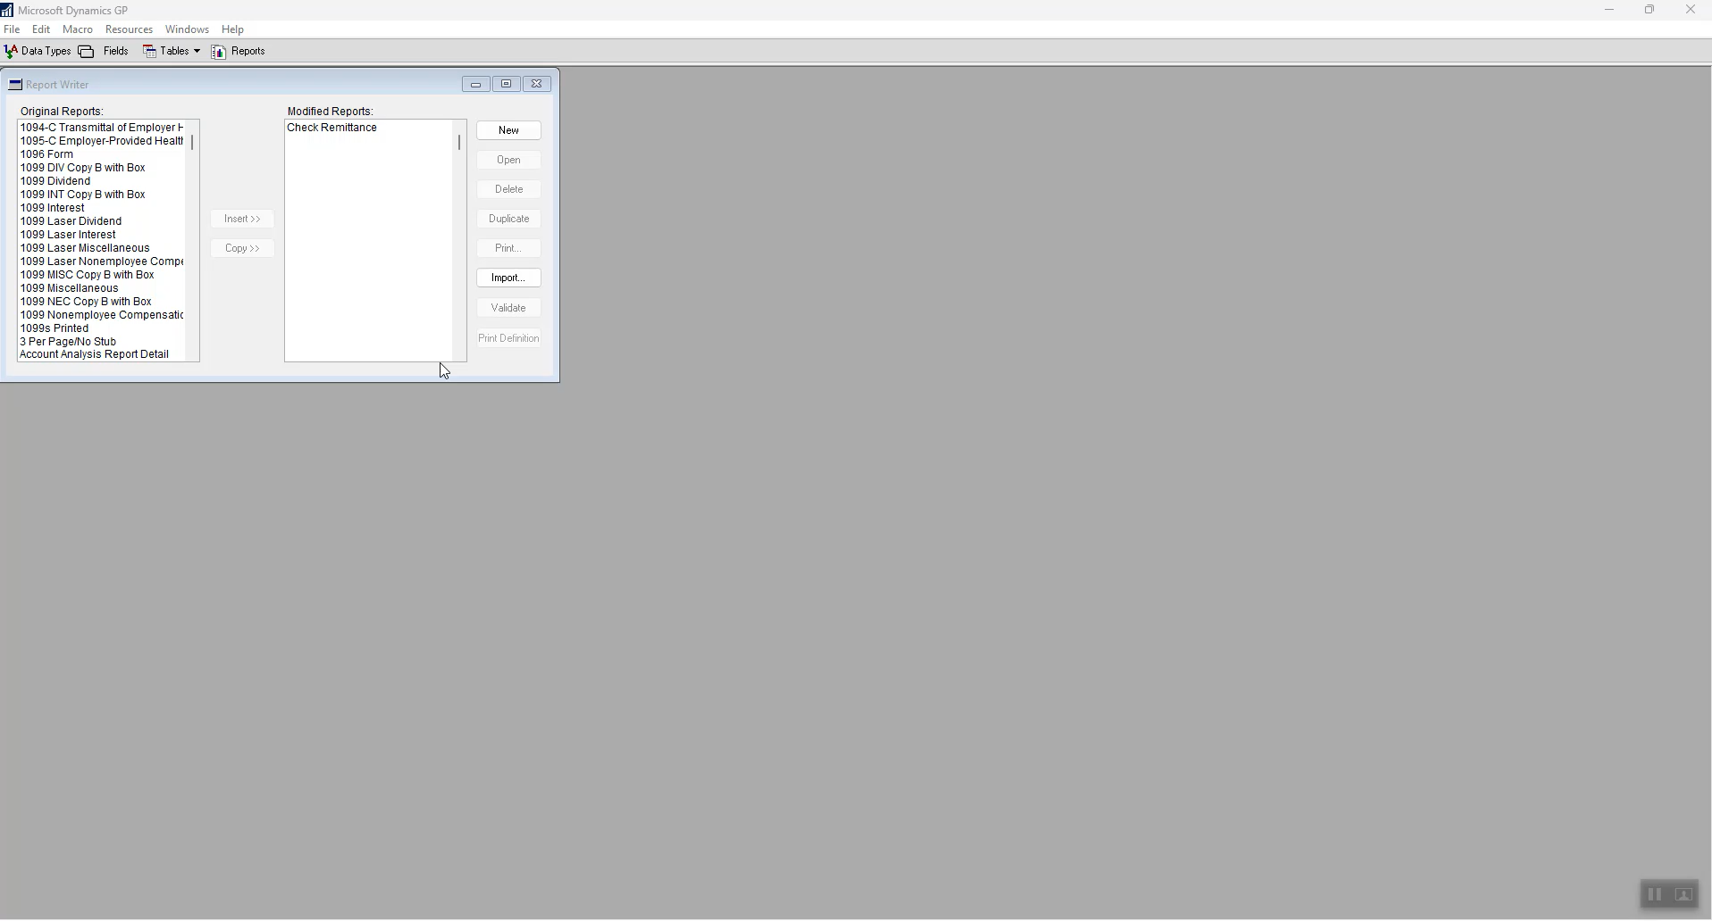
Importing XML Into Existing Word Template
Notes:
For this we are going to prep an example in this slide. This is going to add two fields to the report. Then we are going to export the XML.

Slide 19
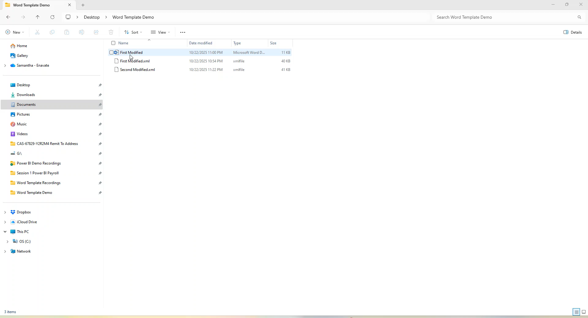
Import XML Into Existing Report
Notes:
Notice at the end of this specific demo I am turning on the gridlines. These are important to know where the cells are in the file and allow us to edit them further.

Slide 20
Editing Word Templates Files

Slide 21
Uses For Advanced Formatting Techniques
Custom Fields
Logos
Format Table Graphics
Outline Sections
Notes:
As seen in the editing of the XML you can go into Report viewer to add a field into the report and then import the XML to add the field onto the Word Template.
Add and configure custom fields in Word templates
Apply advanced formatting for headers, footers, and sections
Customize tables for invoices, purchase orders, and checks

Slide 22
Setting Word For Success
Enable Developer Tab
Provides access to XML Mapping Pane for field management
Save as Word Template (.docx)
Use correct file format before deploying back to GP
Turn On Gridlines
Align tables, fields, and objects more precisely
Turn On Paragraph/Formatting Marks
Helps identify hidden formatting issues
Use the XML Mapping Pane
Map Dynamics GP fields directly into Word templates

Slide 23
Troubleshoot Common Issues
Fix alignment and spacing problems.
Resolve missing fields and mapping errors.
Manage deployment and distribution challenges.
Notes:
As you can see in the prior demo we turned on gridlines. Many times the first item on this list is caused by not knowing where the fields begin and end. Typically once you can see them you can right click and split the cell and move the cell to where you need it to start and end. I will be showing this in the next demo.

Slide 24
Before You Edit
Know where the field’s data originated.
Know the needed changes.
Report Writer or Word Template.
Identify your fix.
Notes:
Let’s talk about the first common issue. Resolve missing fields and mapping errors.
Know where the field’s data is located. Meaning the we need to know where the data is starting. IS this a header field from the Report Writer. Was this a line directly written into the Word Template.?

Slide 25
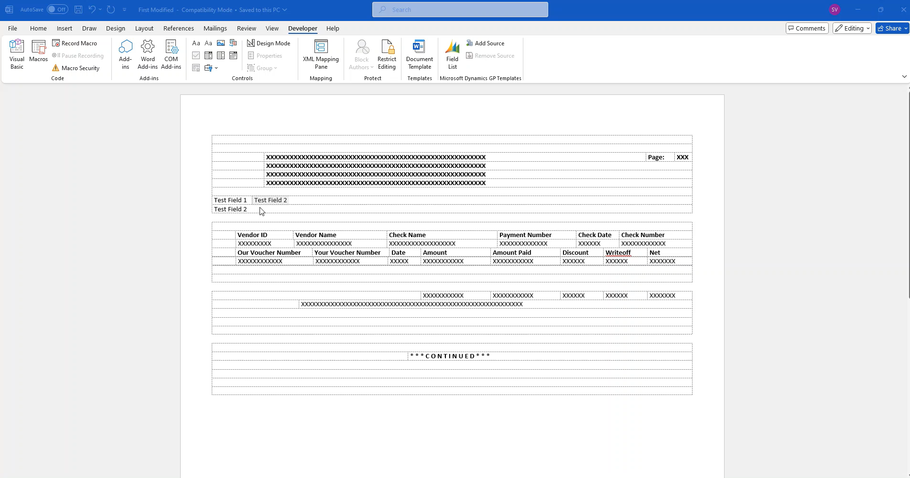
Word Modifications

Slide 26
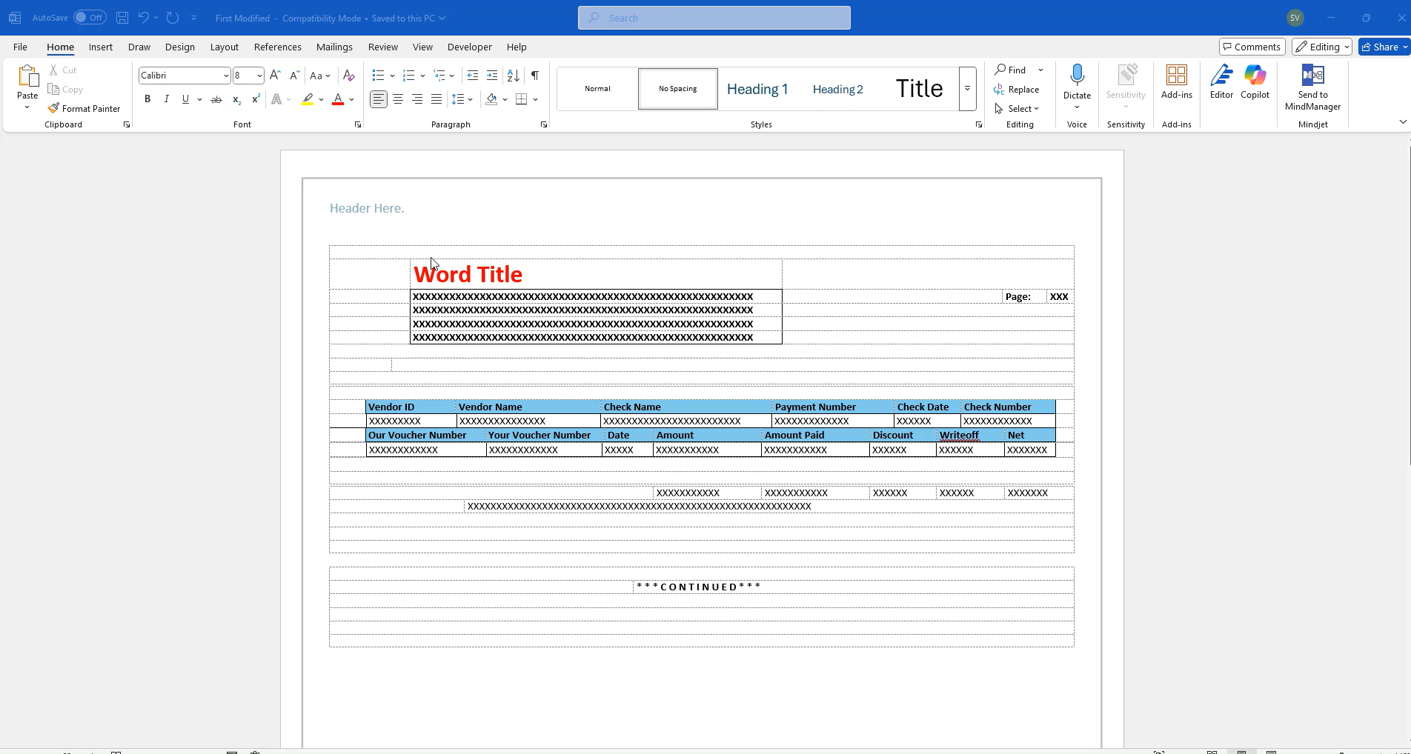
Paragraph Marks & Correcting Gaps
Notes:
The solution is to change the default font for the word template document.
To change this go to Home tab and then select the Font Dialog box Launcher.
Select the font and size you want. To make the space on the word template small I would recommend 1pt size.
Then select Set as Default
Then select This document only.
Then select OK twice.
You will need to resize the tables to be back to the correct font size while

Slide 27
Versioning and Deployment
In Windows
In GP
File Structure
Folder Structure
Naming conventions
Access
Notes:
In windows you will be organizing using the native file and folder structure. The secondary aspect to consider is the security and access to the stored location.
Questions that should be asked:
Who should be able to edit the templates?
If I got hit by a bus tomorrow, will the organization be able to locate them? Are they stored on an obscure local folder?
I would typically recommend a shared folder with access to only those that need to edit the formats.
Then when we import back into GP we have additional considerations. We need to decide on the naming convention.
When you import a Word Template into GP it will take the name of the file. If the name already exists in the word template then it will allow you to override the existing report.
When this is useful is when we are creating reports.

Slide 28
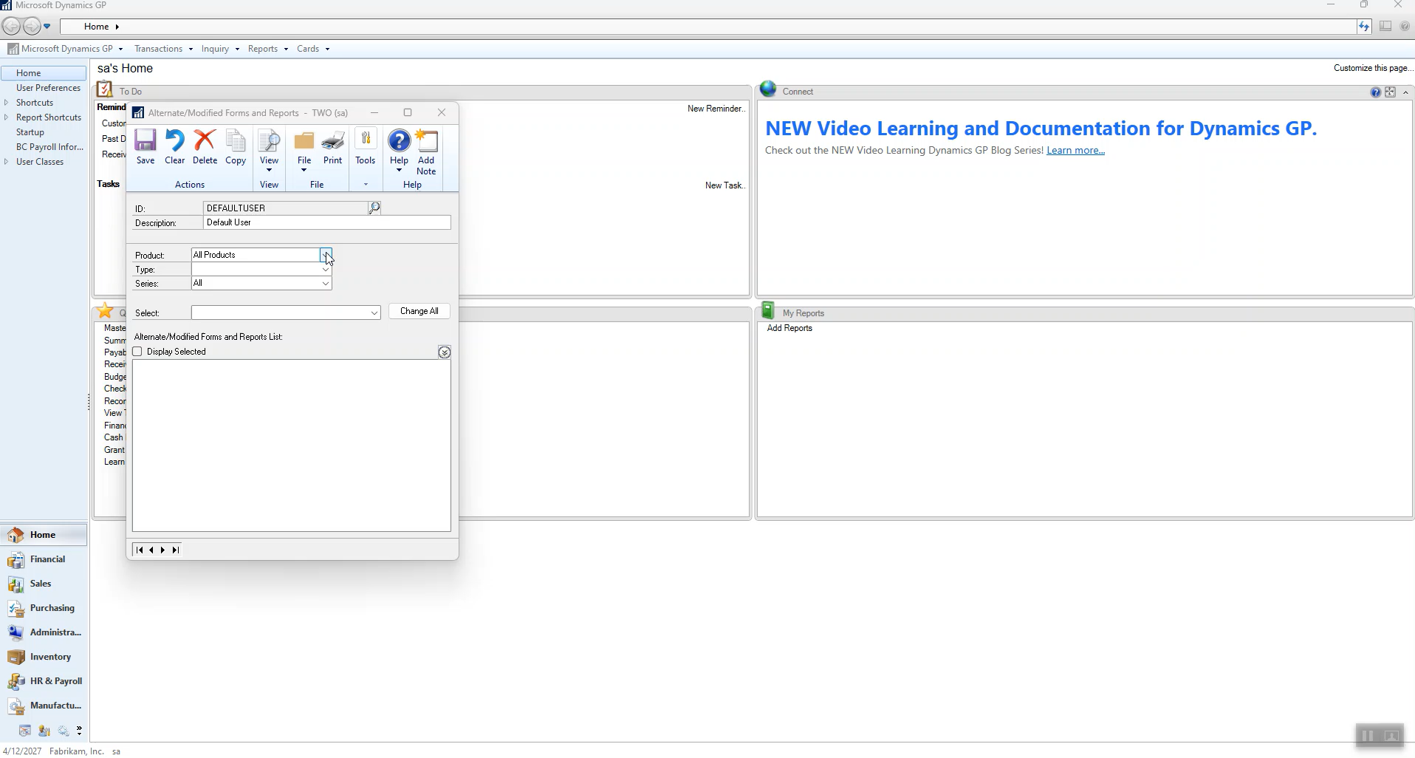
Importing Edits Into GP

Slide 29
References
https://www.enavate.com/blog/how-to-create-a-standard-word-template-for-microsoft-dynamics-gp
https://www.enavate.com/blog/how-to-create-a-modified-word-template-for-microsoft-dynamics-gp
https://learn.microsoft.com/en-us/dynamics/s-e/gp/mdgp2010r2_wordtemplategenerator_333

Slide 31
DYNAMICS GP
© 2025 Dynamic Communities. All rights reserved.

