Slide 1



GP
San Antonio, Texas
October 13-17, 2024

Slide 2
Reporting Talks before Money Walks - Understand How to Read your Costing Reports.
Understanding your GL processing, the subledger, and reporting.
Kyana Brooks, Client Care Expert, Enavate

Slide 3


Your speakers
Samantha Vislay
<title>
Enavate
<BCUG/NAVUG volunteer positions>
Kyana Brooks
Customer Care Consultant
Enavate
<BCUG/NAVUG volunteer positions>

Slide 4
Session Agenda
Understand how to pull reports.
Know how to easily identify errors
Understand where errors need to be corrected.

Slide 5
Do not make any adjustments in the GL.
YOU WILL BREAK YOUR RECONCILIATION REPORTS
All adjustments should be made in the subledger.
If adjustments cannot be made in the subledger than consider an inventory reset, training, and reaching out to an expert.

Slide 6
What reports should be pulled
General Ledger
Smartlist – Account Transaction – Current Inventory Journal
WIP Account
Inventory Finished Goods or Raw Material Account
Labor Account
(Optional) Professional Services Account
Trial Balance Summary or Detail
Inventory
Historical Inventory Trial Balance (Summary or Detail)
(Optional) Purchasing Receipts Report (IV10200 Header; IV10201 Detail)
Purchasing
Smartlist - Receivings Line Items
Manufacturing
Smartlist - Work in Process
Activity Report – 4 MOP Reports
Work in Process Summary
Should match your WIP smartlist and GL, If it doesn’t then you pull the other 3
Work in Process Detail – Component
Work in Process Detail – MO
Work in Process Detail - Site

Slide 7
Common Errors
Missing Transactions
Cost Differences
Material (PO Item Setup, PO Invoicing, Landed Costs, and Adjustments)
Labor (Direct or Indirect)
Machine
Outsourcing (MOP-POP Link)
Incorrect Accounts
If you are using a scanner to calculate
labor time, call an expert.

Slide 8
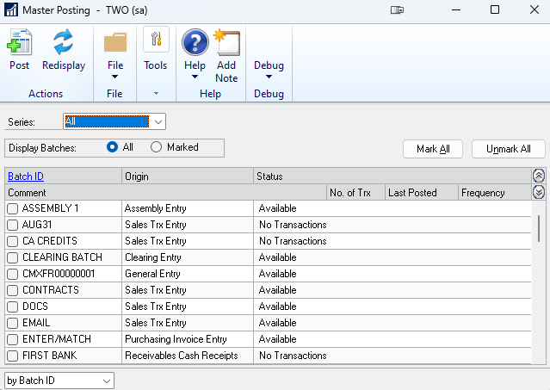
Missing Transactions
Check series and/or master post in Subledger and General Ledger.
Check Batch Recovery for stuck transactions.
All posting to occur by the end of the period.
Notes:
All posting to occur by the end of the period.
So the first thing we will look at is the missing transactions. What we will first look at is in the series or master posting in the sub ledger and general ledger. We will usually start from the sub ledger and work her way to the general ledger. It is important to always remember everything flows to the general ledger so you start at the wheat of origin and follow the flow through the system.
Meeting we would check the sub ledger, check the general ledger, then we would check the batch recovery to see if something hung up in transition.
Let's say everything posted or appear to have been posted and nothing is hung up. What does this mean? This means that either there is an missing accounts on a batch that sitting in the general ledger. It could also mean that a batch did not post through to the general ledger posted to the general ledger. If the batch did not post through an is no longer currently in the general ledger did not get hung up in was posted in the sub ledger this means that somebody could've accidentally deleted that batch. In order to correct this, you'll have to do a general ledger entry. Another alternative, is that something could posted to the wrong. In you have a timing issue on your hand.
Could be missing an account or outside of a period.

Slide 9
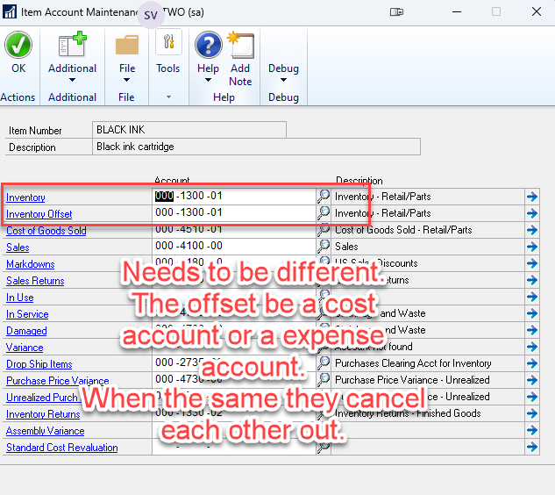
Missing Transactions – Missing Account
Go to >> Inventory >> Setup >> Item Class >> Accounts >> Item Class
Confirm account debit and credit are different.
Will need to check Item level and class level.
Class Accounts Set up Costing.
Notes:
Let's talk more about the missing account.
What this means is that when you go in to your item classes, and go into the account set up, you are looking at your inventory and inventory offset accounts and they are the same.
When this happens it is considered a wash within your general ledger. To correct this, you have to make general ledger entries for items that have already been posted.
Now in the subledger, You will also need to create a transaction.
You will create a debit and credit which reduces inventory from the same account and increases inventory of the same quantity and value in the inventory main account and offset account.
After this is corrected, You will need to change the accounts on the item class or item to correct moving forward.
If you have current inventory, run the historical trial balance. It will be missing a GL number for the account where this occurs.

Slide 10
DEMO 1
Item card account
Class ID accounts
Global accounts

Slide 11
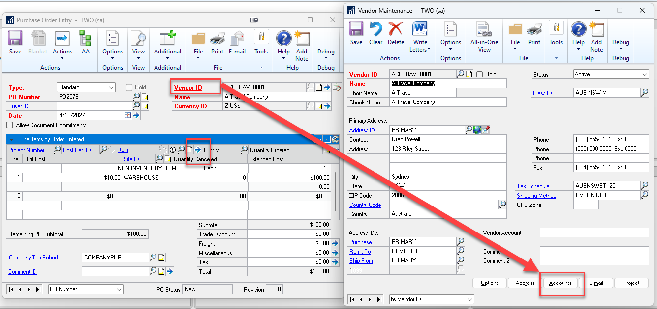
Cost Difference – PO Section
Notes:
Account setup plays a major role in many of the costing issues seen. Knowing how these account are setup and how they flow through the system will help you determine where your problems are.
Let’s take a look atour next section here. This is an example of a PO. We are drilling back into the vendor and taking a look at the accounts. On the PO you can also drill back into the item detail to see which account is assigned to that line.

Slide 12
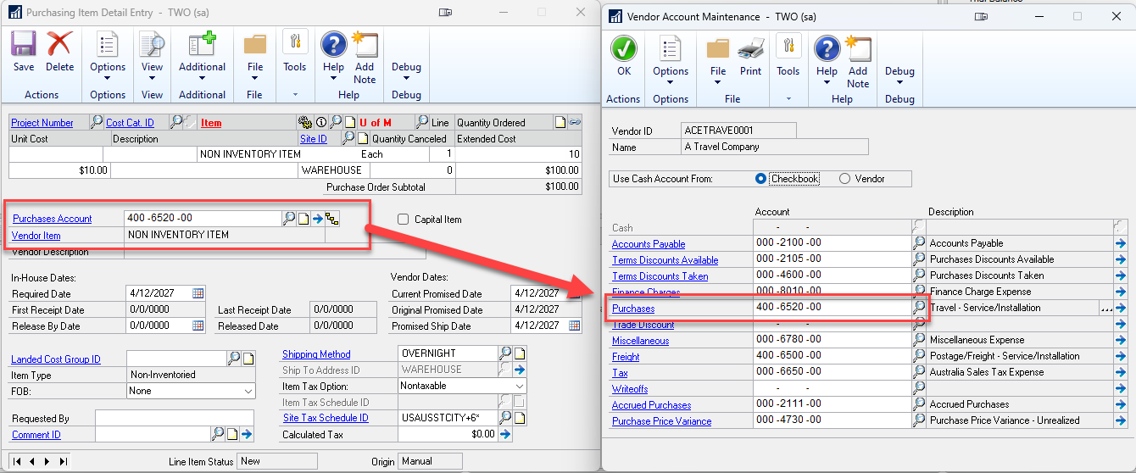
Cost Difference – Account for Non Inventory
Notes:
Here is the drill downs. For all non inventory items within GP we will see the purchasing account that is setup on the vendor, vendor class or the global setting.
To avoid issues with non inventory items we can setup the Vendor with the inventory account into the Purchasing Account and Purchase price variance accounts if the vendor is always an inventory vendor.
Typically non inventory items should not go to your inventory account.
Best practice is to create a non inventory item services or misc within inventory. When you create an item for that service it can be added to your Bill of Material.

Slide 13
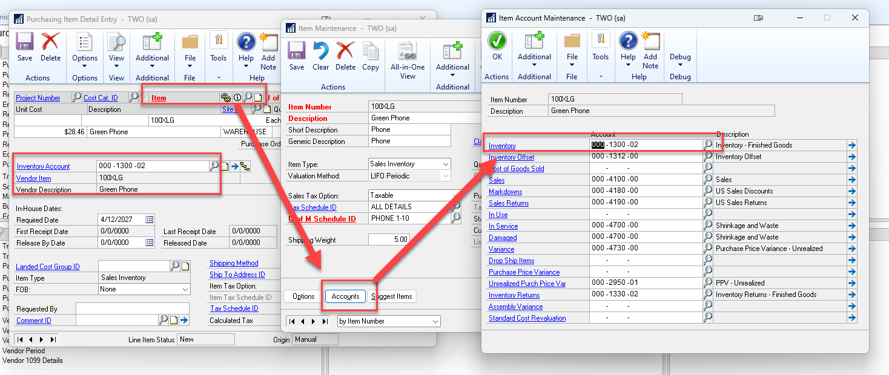
Cost Difference – Account for Inventory
Notes:
Here is an example of an Inventory item. This will pull from the item card’s accounts. If it is assigned a class then it could also pull from the class ID.
If you have more than 10 vendors that are setup incorrectly, these can be updated via SQL with an expert to adjust the Account Index. You can also use a Macro to update the field as well.

Slide 14
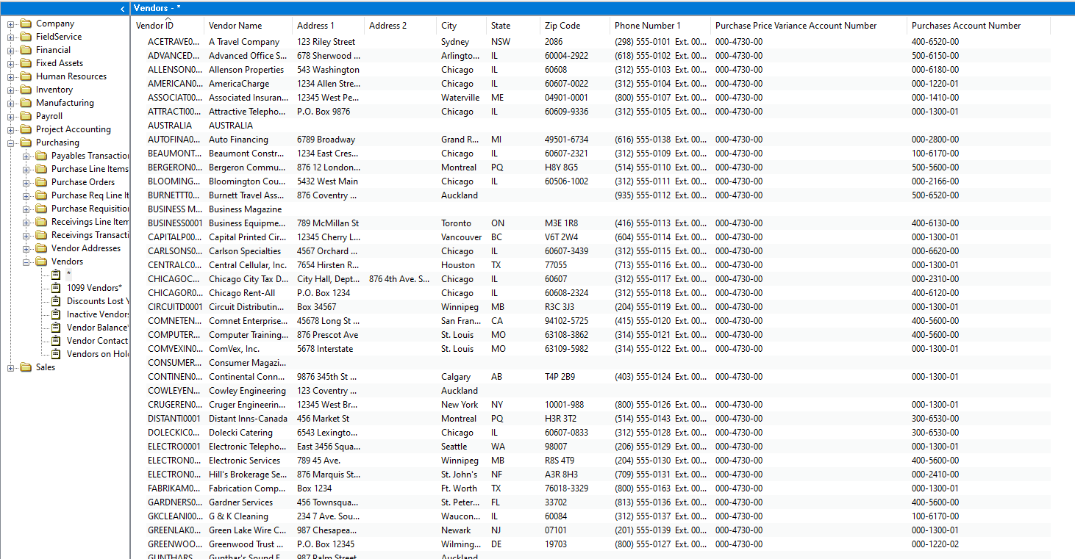
Locating Accounts with Smartlists
Notes:
Another alternative is to use the Vendor smartlist. We can add the Purchase price variance account number and the purchase Account number.

Slide 15
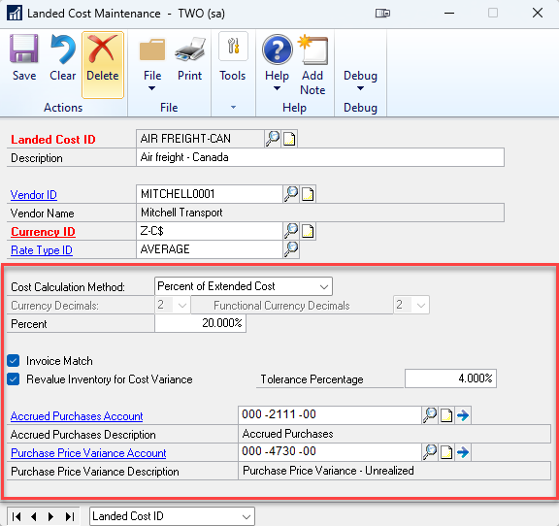
Cost Difference – Landed Costs Accounts
Notes:
Landed costs can also affect the cost differences.
Cost Calculation method
Invoice Match
And Revalue inventory for cost variance and will use the account in this window. The Purchase Price Variance Account should be your inventory account and is a cost account.
CPA and CFO conversation if they ask about the Purchase price variance – UNREALIZED.

Slide 16
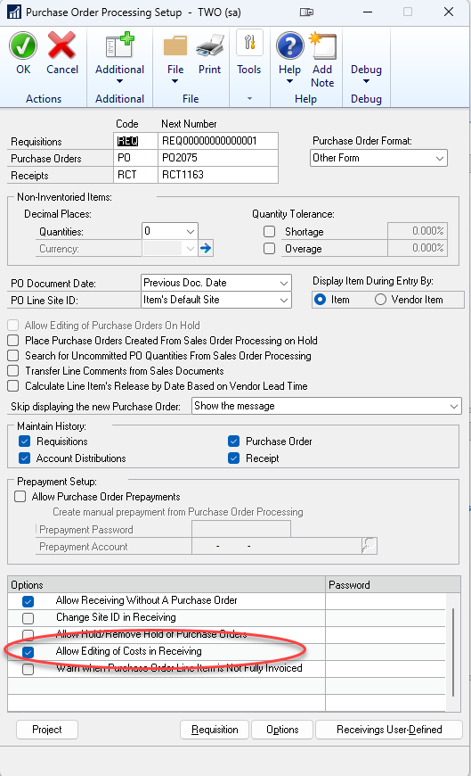
Cost differences – Account Global Level
Notes:
We need to make sure that you know where the costs are changed. You need to know what your environment is doing.
How complex are your bill of material. How many layers are in your Bill of Material? Only raw material purchased or raw material sub assembly then there is a complex BOM.
If it was purchased then it is within purchasing.
We need to first look a the posting account setup.
*This is a global field. **Your item card can override it.
What we typically see
This is blank and someone used a wrong account when purchasing. (On the distributions. Of the invoice/order)
OR
2. Setup is setup for Inventory and is overwritten during the purchasing. (On the distributions. Of the invoice/order)
OR
3. Or the vendor has its own series of accounts that are utilized. (On the vendor maintenance card)
Always purchasing for non inventory items

Slide 17
DEMO 2
Show PO with Non inventory Item
Show PO with Inventory Item
Notes:
Step 1: To understand Inventory Item vs Non inventory item.
If inventory it should follow the inventory card setup.
If non-inventory it should follow vendor or global setup.

Slide 18
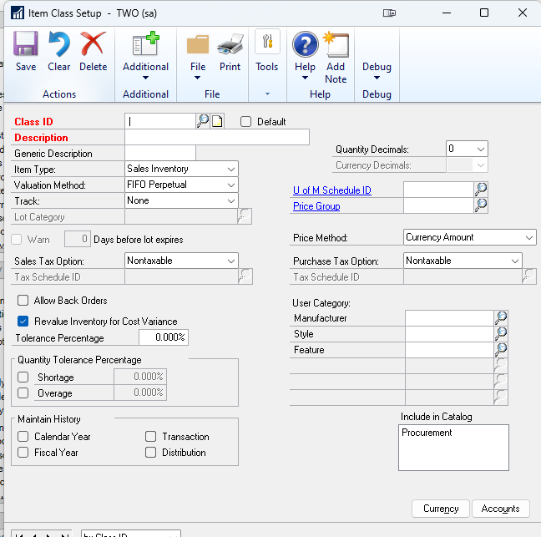
Cost Differences - Item Class Setup
Verify that the Revalue Inventory for Cost Variance is selected.
Verify that the accounts for your Purchase Price Variance is your Inventory account number.
TEST FIRST BEFORE IMPLEMENTING
OR CHANGES
Notes:
Okay now that we've looked at the accounts set up and how that affects purchase order, let's look at another set up that we need to be aware of.
The first this is to check the Item Class Setup for what behaviors the system was told to follow.
Okay now that we've looked at the accounts set up and how that affects purchase order, let's look at another set up that we need to be aware of. That is the Revalue Inventory for cost variance. We need to make sure that this is selected and that the purchase price variance is your inventory.
If you have inventory going through your system that does not have the selected the that could potentially throw off your costing. It will not record revaluations done within purchasing. With this selected if the invoice is received at a different price then it will revalue the inventory into the inventory account. It will revalue all the inventory that is on hand or in Work in Progress for that cost layer.

Slide 19
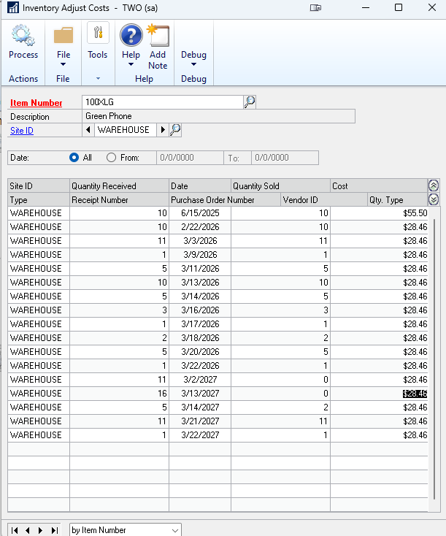
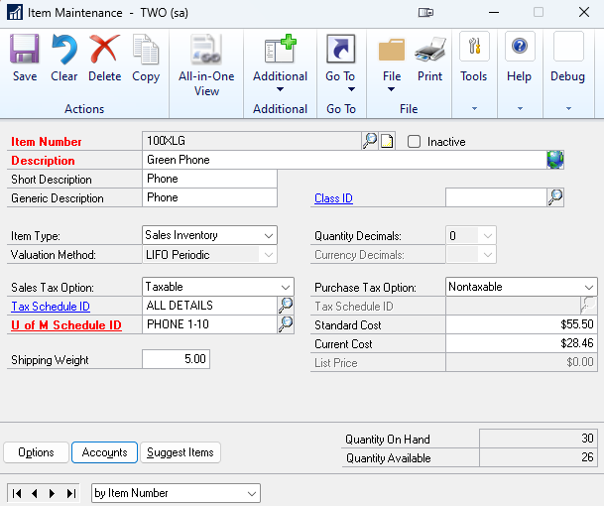
Cost Differences - Inventory Adjusted Costs – Account Item Level
Adjustments here are considered from manufacturing transactions, and inventory adjustments.
PO Receipts are also displayed.
*Go to>>Inventory>>Utilities>>Adjusted Costs>>Ensure each costs has an amount. Then verify accounts on item card.
Notes:
Now let’s discuss the cost layers and how to review and correct the cost differences. For this we are going to look at two places the adjusted cost window in the item maintenance.
We need to ensure that each cost has an amount to them. You will be looking for items that have an abnormal change to the cost.
You will also need to be sure you know what valuation method you are using. In this example we are using LIFO Periodic. Standard costed items will use the standard cost maintenance and standard cost change windows. Therefore if you see a substantial change in cost look to your standard costs windows to understand where the change occurred.
Perpetual items (actual cost)
Periodic items (standard costs.)
Adjustments here are considered from manufacturing transactions, and inventory adjustments. PO receipts can also appear here.
When you have a zero amount you will correct in the item card using the Current Cost.
If there is a quantity on hand changing the costs will affect the inventory and it’s offset accounts.
If it is a quantity on hand where part of the layer was sold it will affect COGS, WIP, Inventory, and Inventory offset accounts (if it is within a closed year, it will affect retained earnings Be Careful!!!!!!).
If you have any specific questions on this, please take one of my business cards and we can schedule you to meet with Kyana Brook who can go over your specific issues.

Slide 20
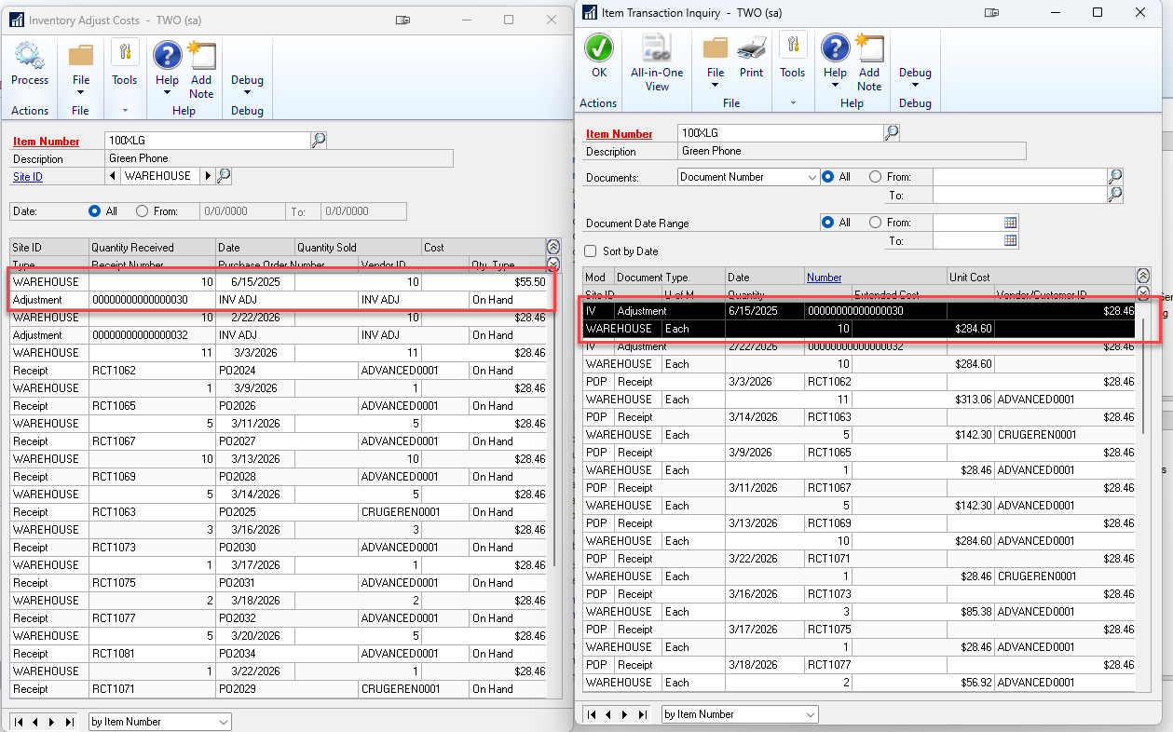
Cost Differences - Inventory Adjusted Costs – Inquiry Window
Notes:
We can use the Item Transaction inquiry window to drill back further to investigate the documents behind the cost layer to determine why a cost was changed.

Slide 21
Cost Differences – Why have my costs been altered?
What is my valuation method, perpetual or periodic?
Is this an adjustment (IV adjustment or MO receipt) or a PO receipt?
Are you looking at a component that is part of a Manufacturing Bill of Materials?
Is this a real change?
Was costs changed in a PO?
If it was $1 and was received at $2 than this is real.
If it was an adjustment and posted, then it could be incorrect.
Notes:
These are some questions that you need to ask yourself when dealing with the costing troubleshooting.

Slide 22
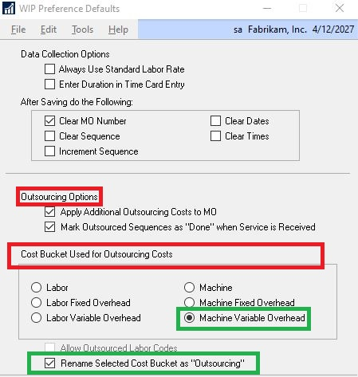
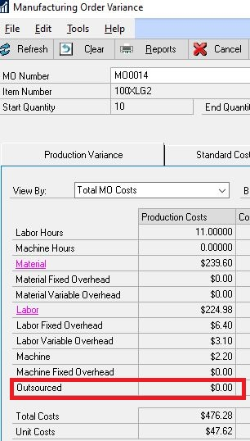
Cost Differences – Outsourcing Costs in WIP Preferences
Outsourcing Options
Additional OS Costs
Mark OS Sequence
Cost Buckets
Use for OS Costs
Notes:
Within the WIP preferences, there are two settings in here that will have an impact on costs and how they move through your system.
Under the outsourcing options you have two selections. you can apply additional outsourcing costs to the manufacturing order.
Marking the OS sequence will allow all purchase order lines for the service to have a receiving status.
The second setting we will be looking at is witch bucket is selected as the outsourcing costs. When tracking through your system this will allow you to know where you should look. You have the option to select which bucket and also rename that bucket to outsourcing.

Slide 23
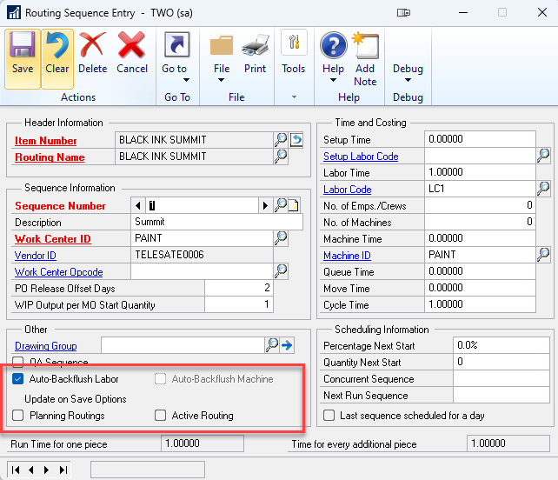
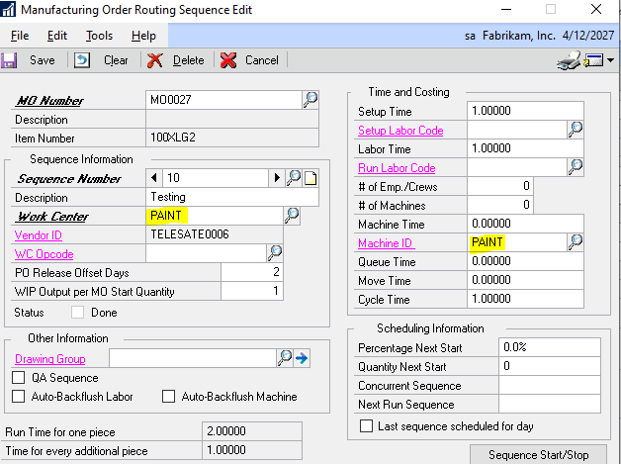
Cost Differences – MO Routers for Timing and Costing
Be careful not to change this information if you are using these as costing buckets if the MO is in process as this can skew reporting data.
Notes:
One thing to consider is also how the manufacturing order links to the work center and machine IDs.
In the setup you can create a routing sequence entry. This is the template that is used in the MO.
So we have this manufacturing routing sequence edit that is from the MO. Once a Routing is added it can be edited on each specific MO.
Be careful when you do this.
Changes to these windows can skew the information in your reports and could be a potential reason for cost differences.
Active Routing: Mark this option if you modify a routing sequence and want the change to also be reflected in other manufacturing order routing sequences.
Planning Routings: Mark this option if you modify a routing sequence and want the change to also be reflected on only planning routing.

Slide 24
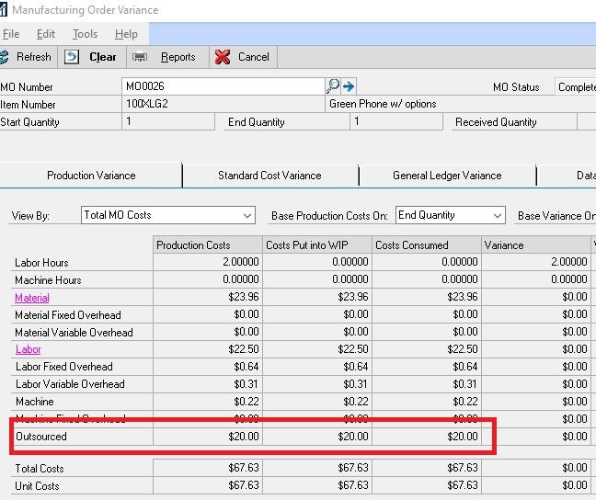
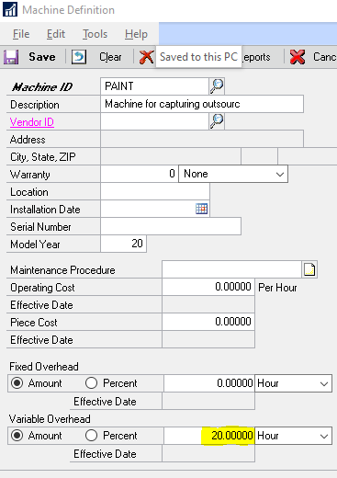
Cost Differences – PO Linked to MO via Router/Machine
Production Variance Tab
Machine Definition
*See MO0026-Standard cost Item, JE3543
Notes:
Machine costs should match the PO Unit costs.

Slide 25
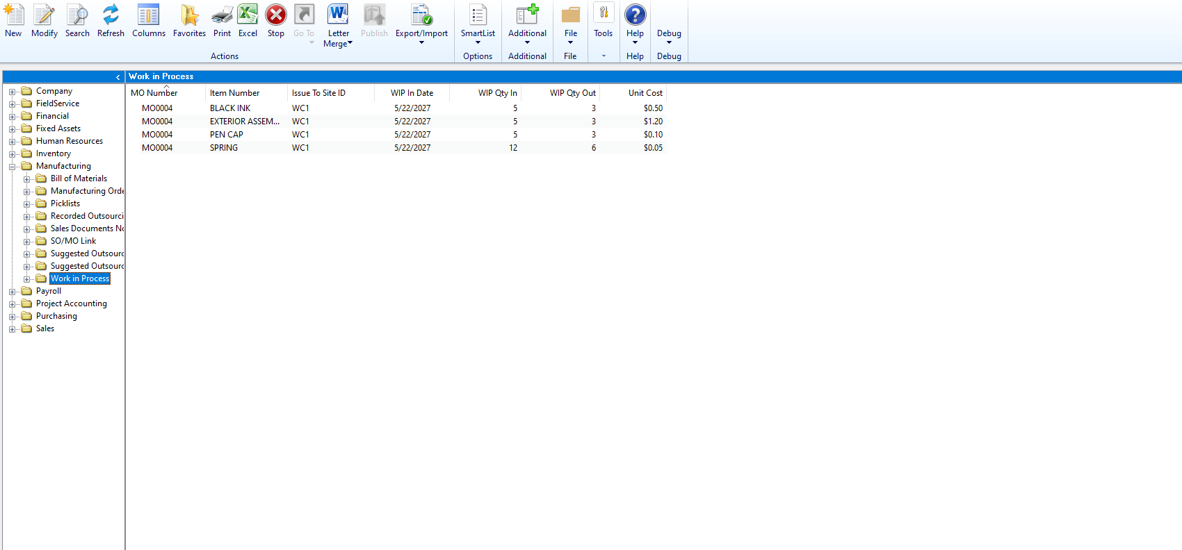
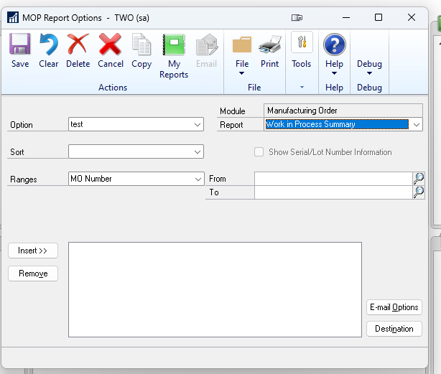
Cost differences – Work In Progress
The Work in Progress smartlist and the Work in Progress summary report should tie out.
Notes:
If you want a report to be created, please feel free to contact Enavate or your System Administrator.
*A report can be created to fit the need of the organization. -SSRS Reports can be developed to add a more robust view for Accounting if desired.

Slide 26
DEMO 3
How to drill back through the Adjusted cost layers.
Editing the WIP smartlist columns
WIP Summary Report.
Tie out the two reports.

Slide 27
Incorrect Accounts
Setup was incorrect upon implementation.
Global
Vendor
Inventory
Vendor Class
Inventory Class
Change occurred during an open transaction.
PO item detail account change.
PO Invoice detail account change.
Item Adjustment
Notes:
Click on cheveron/double arrows.
Now we are at our last section. Incorrect accounts.
There are two main issues in this part.

Slide 28
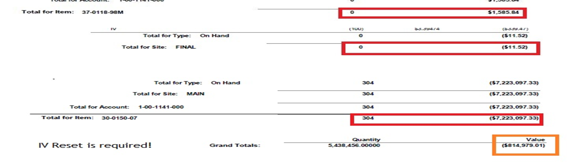
Historical Inventory Trial Balance
Zero Quantity with Value (+/-)
Negative quantity with positive value
Positive quantity with Negative Value
Item number transacting from different GL accounts.
Notes:
Run in summary first. Then run in detail and have to go line by line.
Interested in looking at the value.
Negative and a value is outside of a costing issue.
Zero with a value will require an inventory reset.
304 pieces and the negative amount. Needed a reset.
Gives a detailed view of accounts and transactions. Look for the following to determine the reason for the discrepancy.

Slide 29
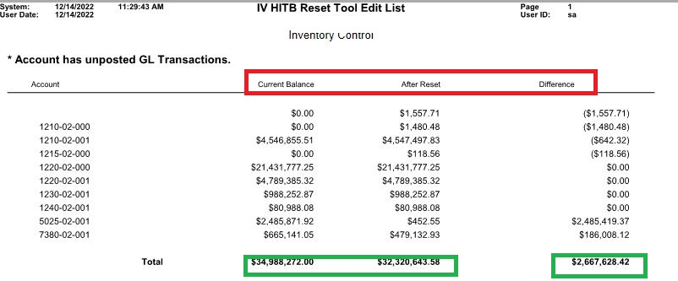
IV Reset
The Inventory Reset Process will correct all GL to SL account transactions that are out of sync based on the Purchase Receipt table in SQL.

Slide 30
Key take-aways
Understanding your setup is key to understanding your costing issues.
Do not adjust your GL to correct your subledger unless necessary and have no other alternative.
If stuck, you should speak with a professional to see what last resorts are.

Slide 32
GP
© 2024 Dynamic Communities. All rights reserved.

