Slide 1



POWER PLATFORM
Orlando, FL October 19-23, 2025

Slide 2

Power BI for Dynamic GP Payroll Insights
Samantha Vislay MCSE, MCSA GP Functional Consultant, Enavate

Slide 3
What you will learn:
Learn how to connect payroll data to Power BI and transform raw data into meaningful insights.
Understand best practices for designing an effective payroll dashboard, including key metrics, visualizations, and interactivity.
What will not be covered:
Creating visualizations. This could easily be a 10-hour session. The resource slide will have links to references for this.

Slide 4
Uses For Power BI
Track employee benefits and costs
Provide metrics into organizational structure (such as departments, positions, etc.)
Employee tracking
Retention Rates
Salary Analysis with tracking salary by department, positions, and other metrics
More in-depth insights

Slide 5
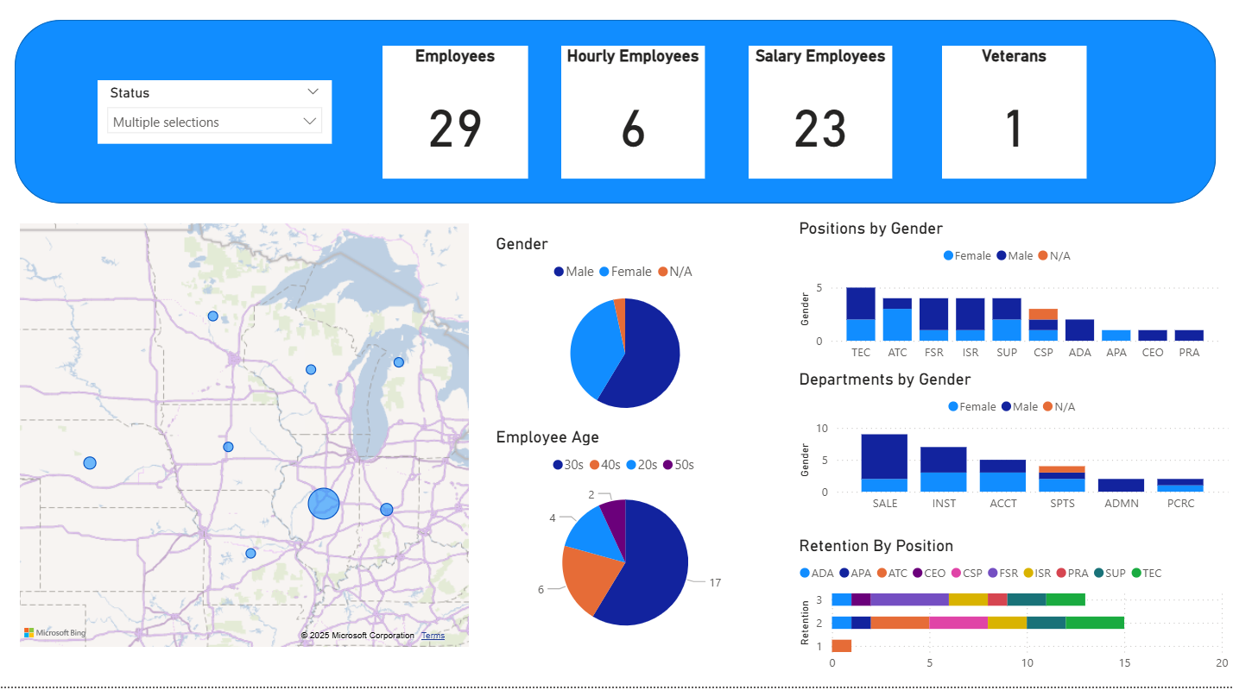
Employee Overview Dashboard
Employee Portion
Status Slicer (UPR00100)
Employee Totals as a Card (UPR00100)
Employee Age (UPR00100)
Employee Gender Breakdown (UPR00100)
Gender by Department (UPR00100)
Gender by Position (UPR00100)
Employee States (UPR00102)
Hourly and Salary Employee Card (UPR00400)

Slide 6
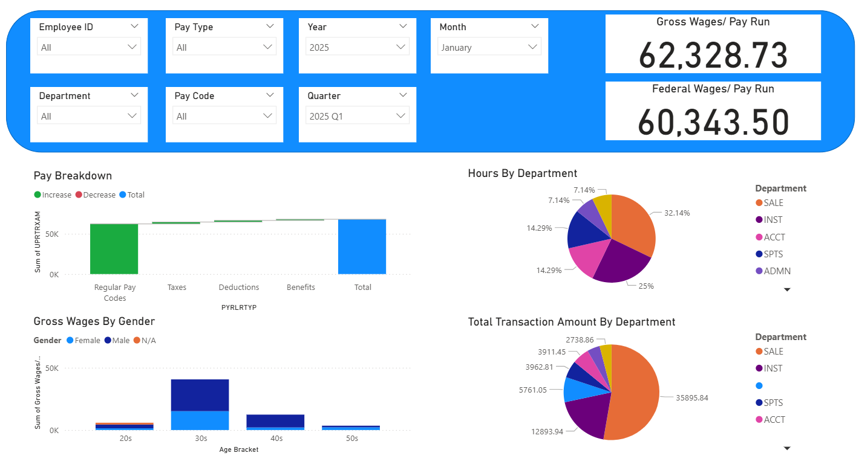
Salary Overview Dashboard
Slicers
Employee ID (UPR30100)
Department (UPR00100)
Pay Type (UPR30300)
Year (UPR30100)
Quarter (UPR30100)
Month (UPR30100)
Gross Wages (UPR30100)
Yearly Breakdown by Gender (UPR00100 & UPR30100)
Total Transaction Amount by Department (UPR00100 & UPR30100)
Hours By Department (UPR00100 & UPR30100)

Slide 7
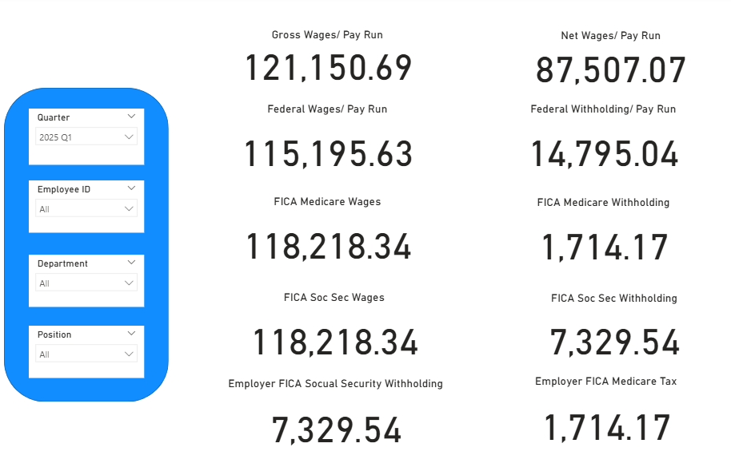
Quarterly Overview Dashboard
UPR30100
Gross Wages (UPR30100)
Net Wages
Federal Wages
Federal Withholdings
FICA Med Wages
FICA Med Withholdings
FICA Soc Sec Wages
FICA Soc Sec Withholdings
Employer FICA Soc Sec Withholdings
Employer FICA Med Withholdings

Slide 8
Database Table Breakdown
UPR00100
Employee Master
UPR00400
Pay Code Master
UPR30100
Check History
UPR30300
Transaction History
UPR00102
Address Master
To pull Employee Data
To pull address information and is linked to the Employee Master table.
To use to calculate salary and hourly employees.
To pull summary data for each paycheck. This data can be used to mimic the Payroll Summary.
To pull detail history that will have the amounts by pay code and pay type.

Slide 9
Notes About the Table Data
UPR30100
Will pull the Gross Wages and Federal taxable wages from this table
Summary data is typically tied out to the Payroll Summary in the period end reports window
UPR30300
UPRTRXAM is the sum of all deductions, benefits, pay codes and taxes
Apply a sort or slicer for the Pay codes to get the Gross from this field
Notes:
On the UPR30100 this will pull the Gross Wages and Federal taxable wages from this table. The summary data on this is typically tied out to the Payroll Summary in the period end reports window.
On the UPR30300 the UPRTRXAM is the sum of all deductions, benefits, Pay codes and taxes. To get the Gross from this field you will need to apply a sort or slicer for the Pay codes.

Slide 10
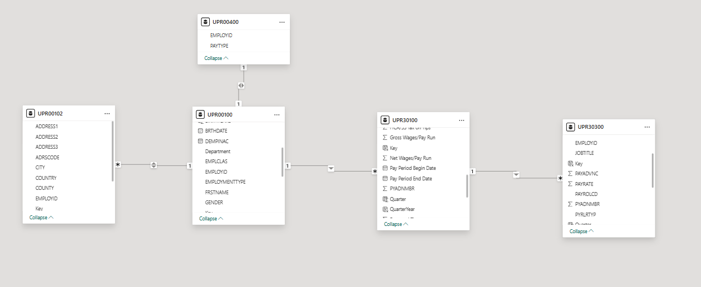
Star Method

Slide 11
Extract, Transform, and Load (ETL)
Extract – Connecting to Data Sources
Pull data from multiple sources (SQL databases, Excel, APIs, cloud apps, etc.)
Use Power Query to bring in both on-premise and cloud data
Transform – Shaping and Cleaning Data
Apply business rules: filtering, merging, column splitting, date formatting
Handle missing values and standardize data for consistency
Load – Delivering to Power BI Models
Load into the Power BI data model for reporting and dashboards
Ensure optimized performance through proper data types and relationships

Slide 12
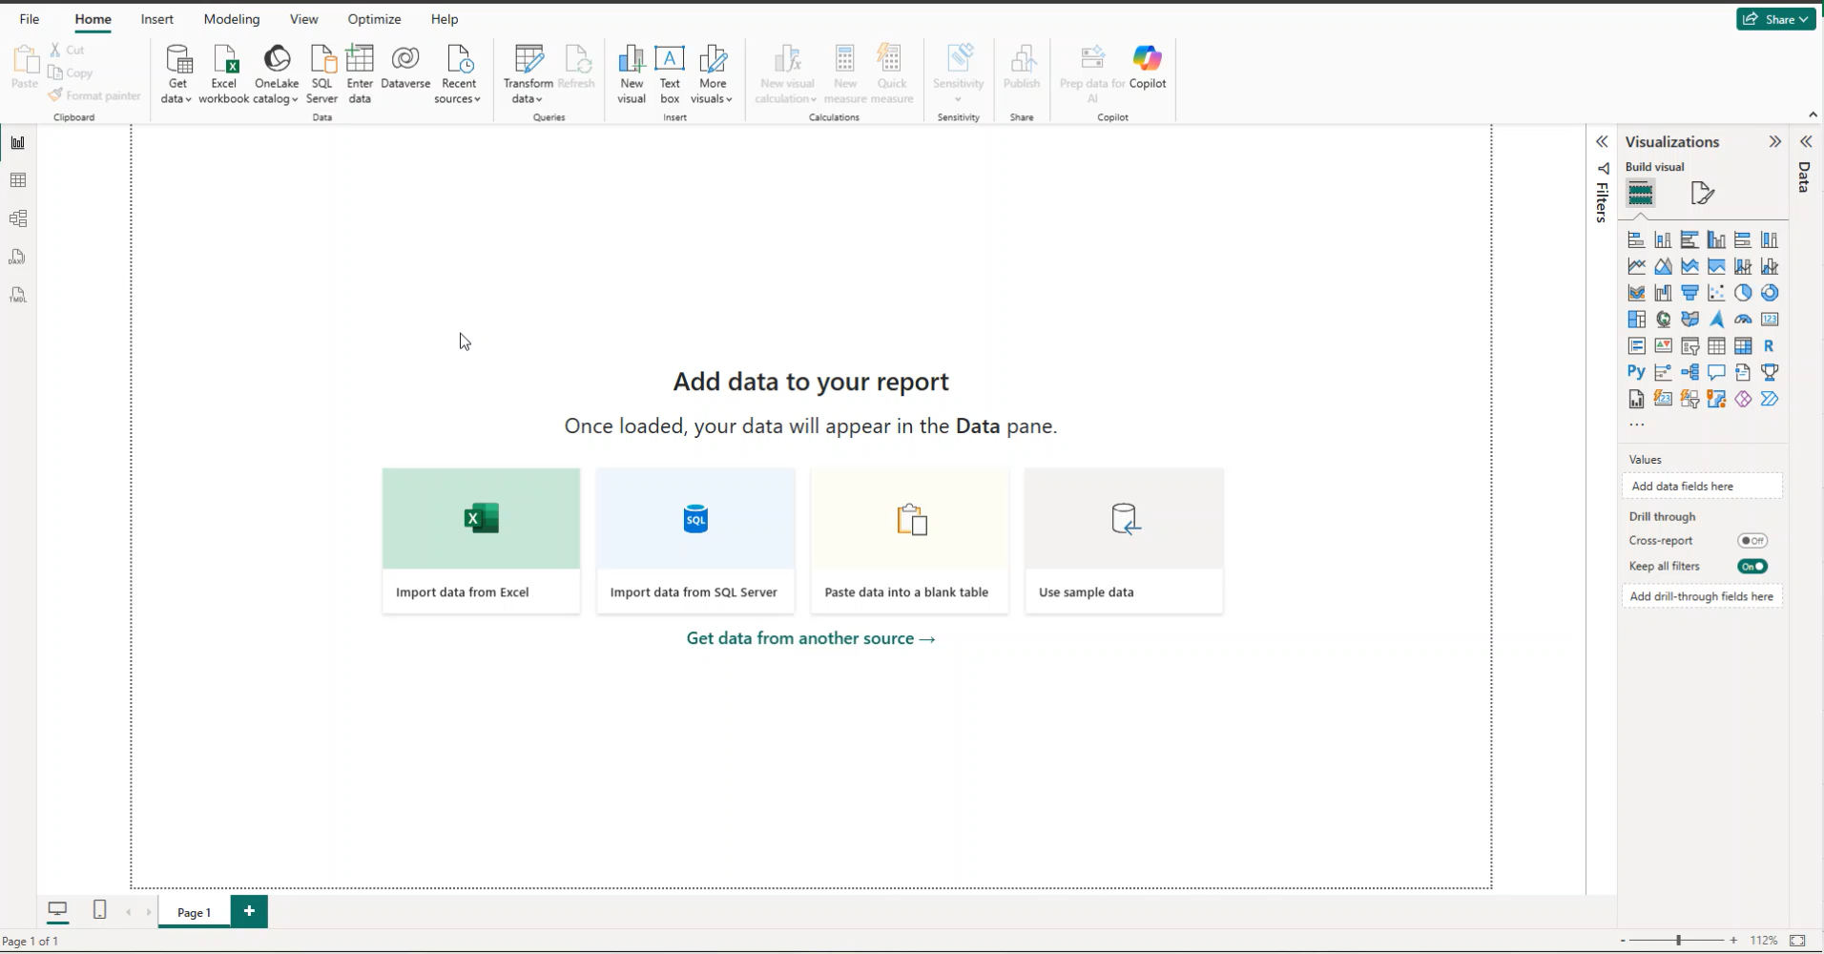
Step 1: Import Demo
Notes:
In the general ETL Power BI calls it import.

Slide 13
Step 2: Transforming the Data
Remove columns that will not be used using Remove Columns
Change the type on number fields to text to allow replacement of the value.
Replace the values for the fields to be readable.
1= Male
2=Female
3= N/A
Example: Gender

Slide 14
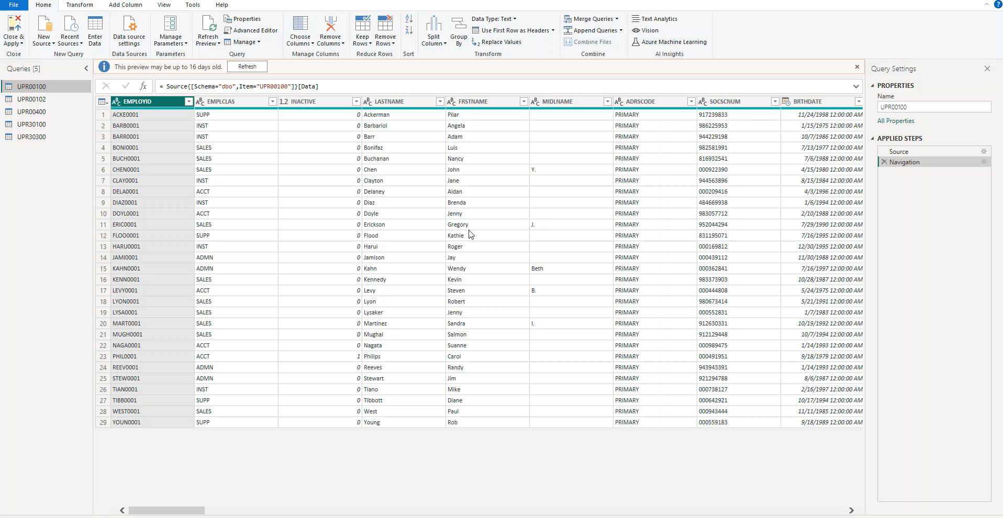
Step 2: Transform Data Demo
Notes:
On this demo you will see we will remove unwanted columns and then change the format to text. After the column is text, we can then replace the values with other fields.

Slide 15
Step 3: Linking Data Option 1
Use the Trim field to remove unseen spacing
Duplicate the columns that will combine for our key
Use Merge Columns to combine the duplicated fields to form the key.
For UPR00100, UPR00102, and UPR00400 we will use EMPLOYID and ADRSCODE
For UPR30100 and UPR30300 we will use AUCTRLCD, EMPLOYID, CHEKNMBR, CHEKDATE, and YEAR1
AUCTRLCD
EMPLOYID
CHEKNMBR
CHEKDATE
YEAR1
Notes:
Discuss how power BI only has 1 main key at a time.
We will first use the Trim field to remove unseen spacing.
After the trim we will Duplicate the columns that will combine for our key.
We will then use Merge Columns to combine the duplicated fields to form the key.
For UPR00100, UPR00102, and UPR00400 we will use EMPLOYID and ADRSCODE.
For UPR30100 and UPR30300 we will use AUCTRLCD, EMPLOYID, CHEKNMBR, CHEKDATE, and YEAR1

Slide 16
Step 3: Linking Data Option 3
The second option is to use the New Column calculation button to create the new field.
Key = UPR00100[EMPLOYID] & UPR00100[ADRSCODE]
Key = UPR00102[EMPLOYID] & UPR00102[ADRSCODE]
Key = UPR00400[EMPLOYID] & UPR00400[ADRSCODE]
Key = UPR30100[AUCTRLCD]&UPR30100[Employee ID]&UPR30100[CHEKNMBR]&UPR30100[Check Date]&UPR30100[Year]
Key = UPR30300[AUCTRLCD]&UPR30300[EMPLOYID]&UPR30300[CHEKNMBR]& UPR30300[Check Date]&UPR30300[Year]

Slide 17
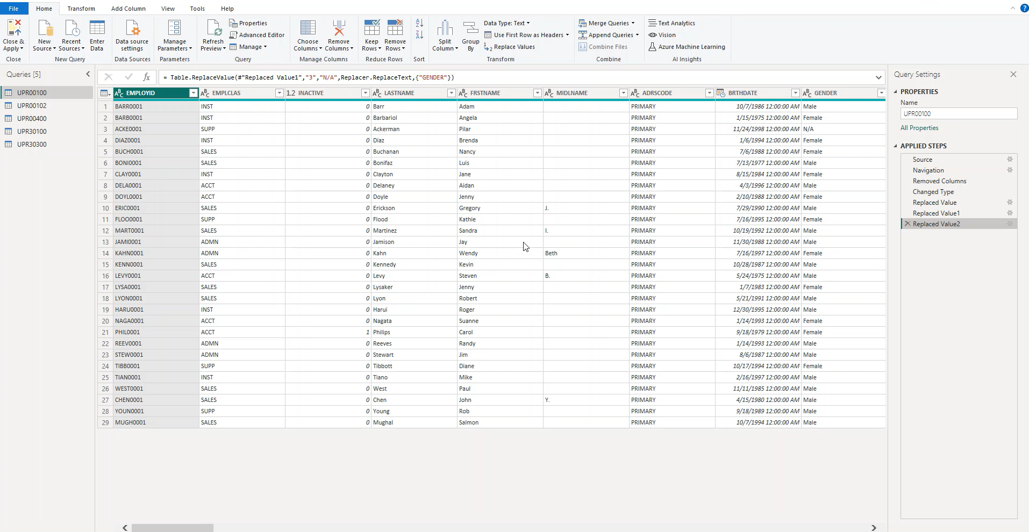
Step 3: Prepare Data Link
Notes:
We will start with trimming the fields that will be combined to create a one to one connection between the tables as we saw on the last two slides. We will then select the two columns in the order we want them to combine. This will have to match between the two tables in order to link correctly.

Slide 18
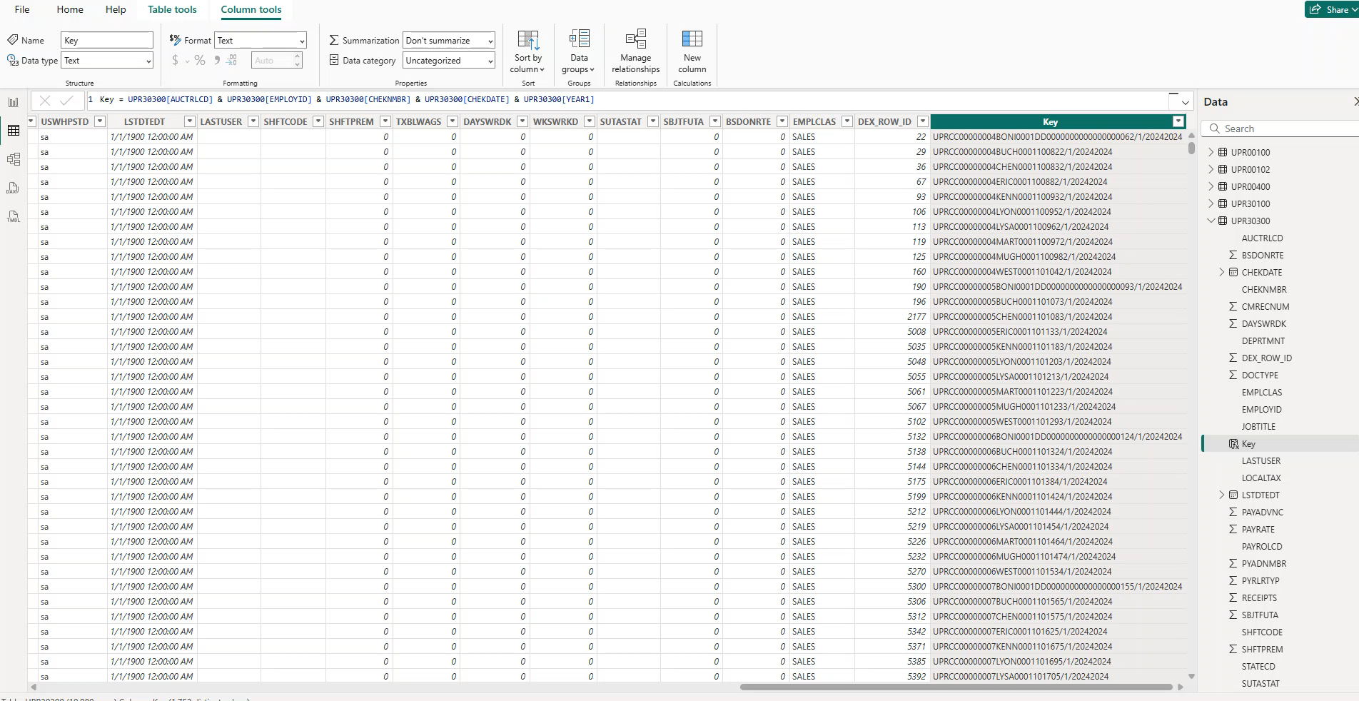
Step 4: Recreate Relationships Between Tables

Slide 19
Creating Visualizations
Notes:
This part could be a 10 hour session creating visualizations. What I am trying to do is give high level of creating a visual.

Slide 20
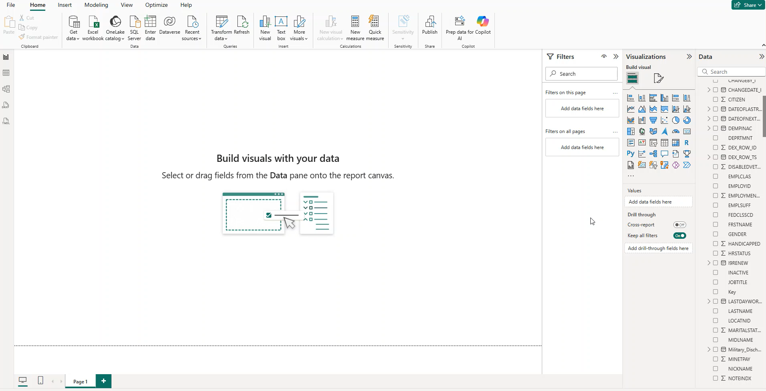
DEMO: Create a Card

Slide 21
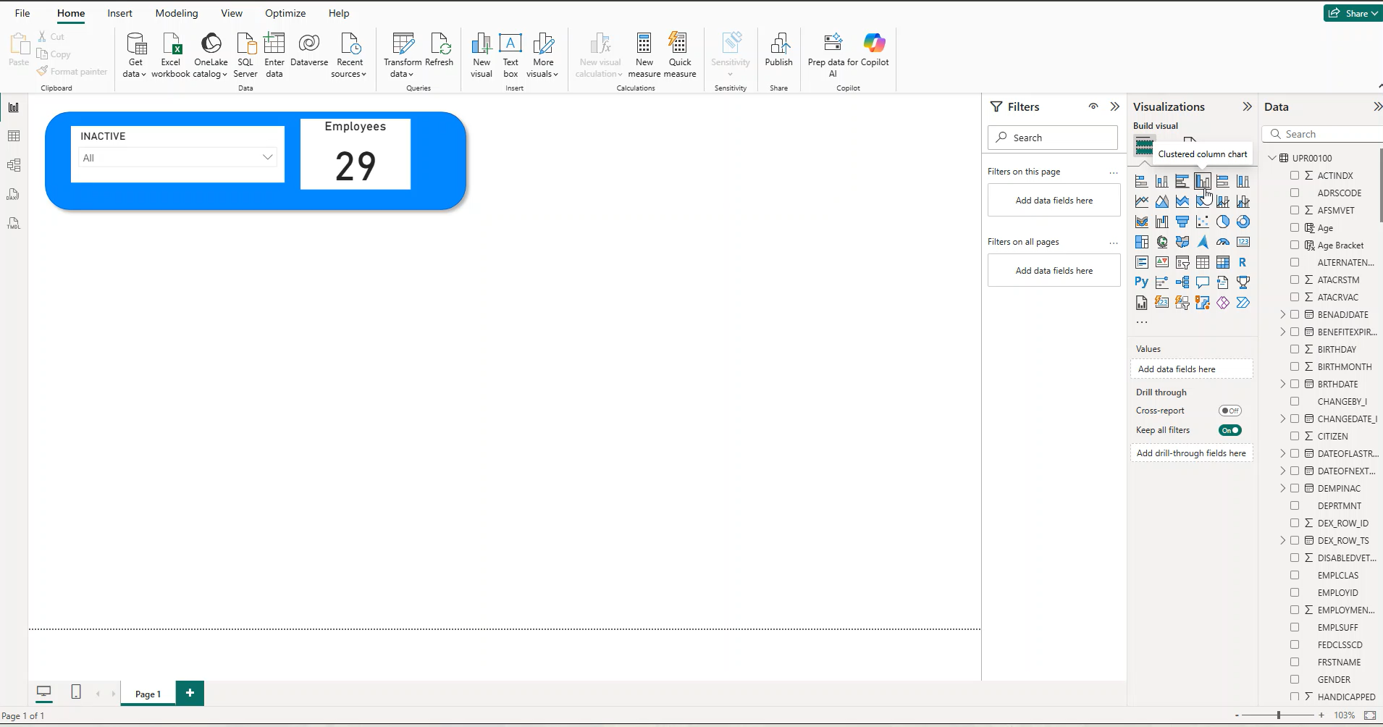
DEMO: Create a Graph and Chart

Slide 22
Suggested Resources
Uploaded to Summit’s portal is the following:
Handout with table references
Copy of this power point slide. Demos were pre recorded for reference.
Power BI Education Sites:
https://learn.microsoft.com/en-us/training/powerplatform/power-bi
https://www.youtube.com/guyinacube
If you want to learn more or see a sample dashboard again, stop by Enavate booth #707 and talk to me.

Slide 24
POWER PLATFORM
© 2025 Dynamic Communities. All rights reserved.

Slide 25
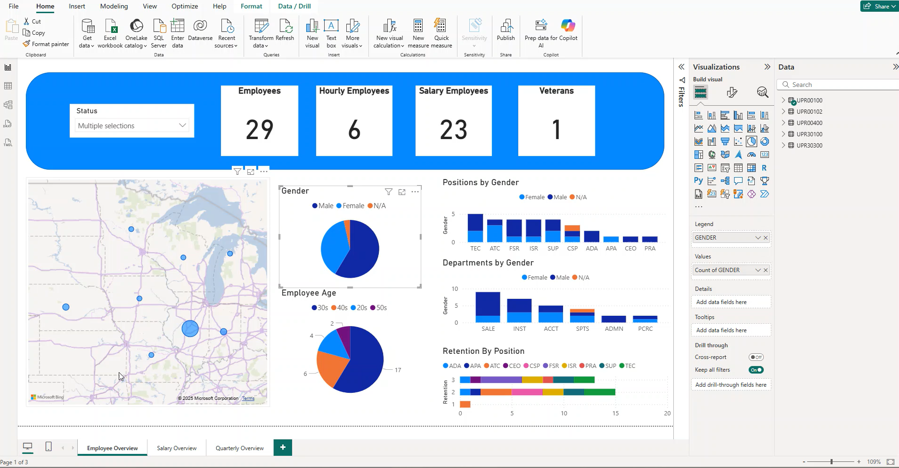
Review of Completed Report

