Slide 1



DYNAMICS GP
Orlando, FL October 19-23, 2025

Slide 2

GP Payroll: Resolving Payroll Calculation Errors
Samantha Vislay MCSE, MCSA GP Functional Consultant, Enavate

Slide 3
Understand the payroll transaction in the system to correct errors more easily
Identify and locate errors
How to correct errors
Notes:
Original bullet 2
Understand the payroll transaction what they system is doing to allow you to correct errors easier.
Simplify error correction by understanding the payroll transaction in the system

Slide 4
Including but not limited to…
Error | Likely Cause | Result
Incorrect Deductions or Benefit Amounts | Wrong calculation method assigned (percent vs. fixed amount); pre-tax/post-tax flag misconfigured; limits or maximums set incorrectly | Direct impact on net pay and tax withholding
Federal Tax Withholding Errors | Outdated tax tables; incorrect W-4 settings; supplemental wages not taxed using correct method. | IRS compliance risk and large discrepancies in employee tax
Overtime Rate Miscalculation | Overtime pay code not linked to correct calculation formula or base rate; blended rate errors for multiple pay rates. | Can result in DOL compliance issues
YTD Accrual Discrepancies | Incorrect YTD carry-forward during year-end close; manual edits to payroll history not reflected in accrual tables; beginning balances entered incorrectly. | Can cause incorrect leave balances and payout errors
Garnishment/Child Support Miscalculations | Incorrect calculation priority; pre/post-tax application error; limits not respected. | Legal compliance risk and employee impact
Missing or Misassigned Taxable Flags | Deduction/benefit code set incorrectly as taxable or non-taxable; pay code not mapped properly to federal/state tax tables. | Can cause under/over withholding and compliance issues

Slide 5
Comon Denominator
Most payroll calculation errors in Dynamics GP share a common root cause:
Incorrect or incomplete setup configuration.
Notes:
The majority of payroll calculation issues in Dynamics GP are not the result of the system “breaking,” but rather of setup choices and maintenance practices. Payroll relies heavily on configuration: tax tables, pay codes, deductions, benefits, and accrual rules all interact to determine employee pay. When errors occur, they can almost always be traced back to how these elements were entered, updated, or maintained over time.
Federal taxes are a prime example. GP does not calculate federal withholding on a per-check basis, but instead uses an annualized method based on IRS tax tables. If W-4 information is entered incorrectly, if tax tables are not updated promptly, or if deductions and benefits are assigned the wrong pre-tax or post-tax status, the result will be incorrect withholding. Similarly, supplemental wages such as bonuses or overtime can be miscalculated if pay codes are not flagged with the correct tax treatment.
Knowing where to look is half the battle.

Slide 6
Pay Attention to These Setup Fields
Notes:
There could be multiple courses on setting up HR and Payroll. I am going to ID the most common causes for payroll errors and list what could happen when each field is ignored.

Slide 7

Setup: Pay Codes, Benefits, and Deductions
Subject to Taxes:
By default, benefits are not included in taxable wages unless one or more of these boxes is selected.
1. Federal: Federal income tax will be withheld from this amount in box 1 of the W-2.
2. FICA Soc Sec: Social security tax will be withheld from this amount in box 3 of the W-2.
3. FICA Medicare: Medicare tax will be withheld from this amount in box 5 of the W-2.
4. State: State income tax will be withheld from this amount in box 16 of the W-2.
5. Local: Local income tax will be included in box 18 of the W-2.
6. FUTA: the benefit will be included in taxable wages for Federal Unemployment purposes. Federal unemployment tax will be accrued on this amount.
7. SUTA: the benefit will be included in taxable wages for State Unemployment purposes. State unemployment tax will be accrued on this amount.

Slide 8
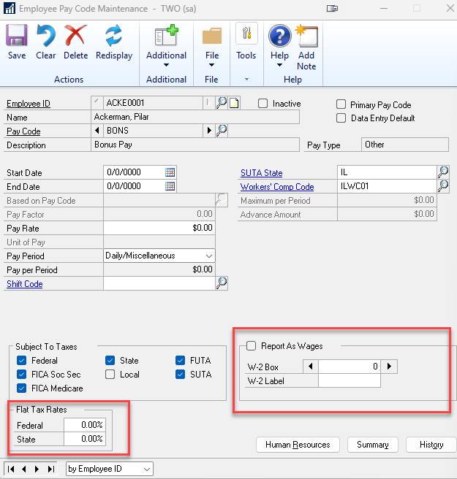
Flat Tax Rates
Overrides the Federal and State income tax withholding amounts as calculated by Microsoft Dynamics GP
Uses the tax tables during the ‘Calculate Checks’ process
Notes:
Flat Tax Rates: These fields are used to override the Federal and State income tax withholding amounts as calculated by Microsoft Dynamics GP using the tax tables during the ‘Calculate Checks’ process.
Report As Wages
Mark if this pay code is for business expenses, and these expenses should be reported as wages on the W-2 statement. Pay Types Not Typically Included in Gross Wages (but may be included in taxable wages):
Business Expenses: Reimbursements for expenses incurred by the employee on behalf of the company.
Taxable Benefits: Benefits that are considered taxable income, such as health insurance premiums paid by the employer.
Tax Sheltered Annuities (TSA): Contributions to retirement plans that are exempt from current taxation.
W-2 Box: enter the number of the box on the W-2 in which the amount should appear, if applicable. You do not need to enter boxes 1, 3 or 5 here, as inclusion in those boxes is determined by the selections in the ‘Subject to Taxes’ fields.
W-2 Label: enter the label that should appear on the W-2.

Slide 9
Report as Wages
Business Expenses Reimbursements for expenses incurred by the employee on behalf of the company.
Taxable Benefits Benefits that are considered taxable income, such as health insurance premiums paid by the employer.
Tax Sheltered Annuities (TSA) Contributions to retirement plans that are exempt from current taxation.
W-2 Box Enter the number of the box on the W-2 in which the amount should appear, if applicable.
You do not need to enter boxes 1, 3 or 5 here
Inclusion in those boxes is determined by the selections in the ‘Subject to Taxes’ fields.
W-2 Label Enter the label that should appear on the W-2.
Notes:
Mark if this pay code is for business expenses, and these expenses should be reported as wages on the W-2 statement. Pay Types Not Typically Included in Gross Wages (but may be included in taxable wages):
Business Expenses: Reimbursements for expenses incurred by the employee on behalf of the company.
Taxable Benefits: Benefits that are considered taxable income, such as health insurance premiums paid by the employer.
Tax Sheltered Annuities (TSA): Contributions to retirement plans that are exempt from current taxation.
W-2 Box: enter the number of the box on the W-2 in which the amount should appear, if applicable. You do not need to enter boxes 1, 3 or 5 here, as inclusion in those boxes is determined by the selections in the ‘Subject to Taxes’ fields.
W-2 Label: enter the label that should appear on the W-2.

Slide 10
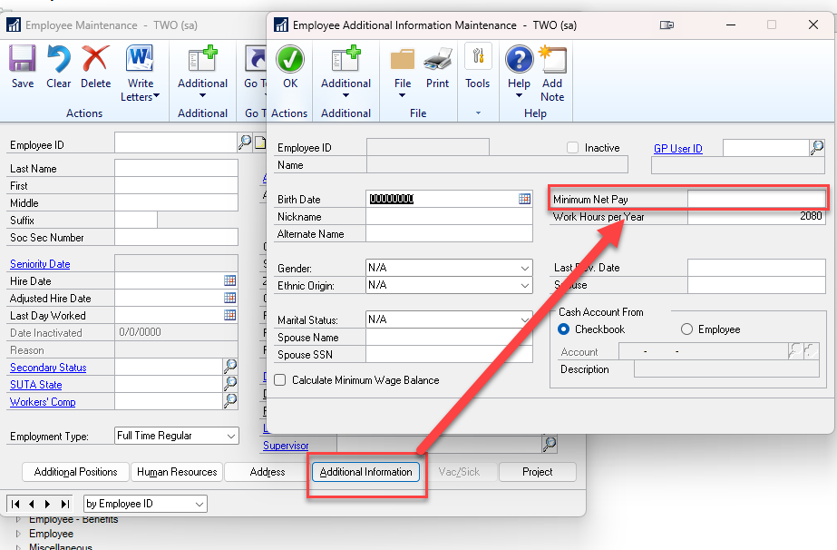
Minimum Net Pay
Deductions that bring the net pay below a set minimum net pay, prevent sequenced deductions from being taken.
This field may be taking up most of the check amount, causing a deduction to drop off.
Cards
Payroll
Employee
Additional Information
Notes:
If you have a minimum net pay amount set up for the employee, and the deductions brings the net pay below the minimum net pay, the deductions that are sequenced last won't be taken.
This field may be taking up most of the check amount, causing a deduction to drop off.

Slide 11
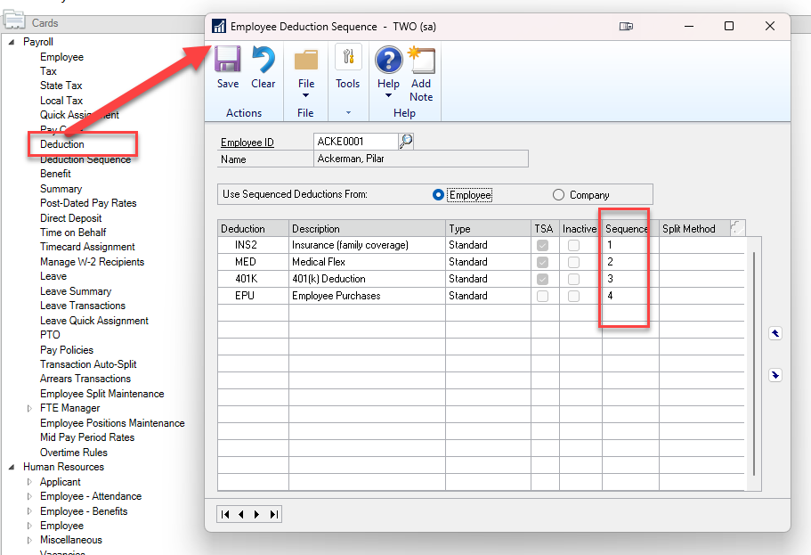
Sequence
If the deduction brings the pay to a negative amount, it will cause the deduction to drop off.
Notes:
Another reason a deduction could drop off a check is the sequencing: causing a deduction to drop off.

Slide 12
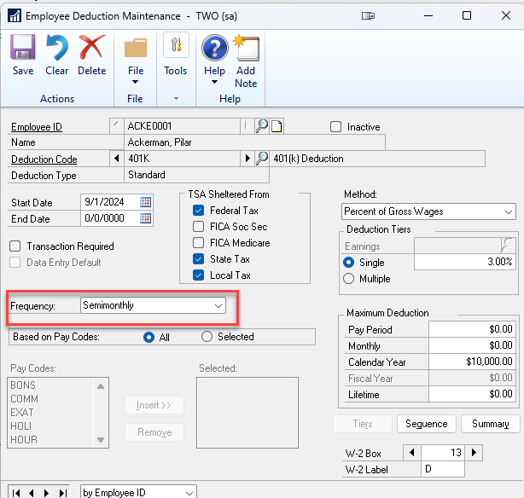
Frequency
Determines how the tax calculation is applied to that deduction NOT when a deduction is taken.
The Pay Period frequency directly changes the annualization formula GP uses:
Weekly → wages × 52
Biweekly → wages × 26
Monthly → wages × 12
Annual → wages × 1
Setting a bonus to Monthly makes GP treat it as if that bonus is received every month, increasing taxable wages in a way that pulls more withholding than Annual.
Notes:
The frequency field determines how the tax calculation is applied to that deduction NOT when a deduction is taken.
The Pay Period frequency directly changes the annualization formula GP uses:
Weekly → wages × 52
Biweekly → wages × 26
Monthly → wages × 12
Annual → wages × 1
So, setting a bonus to Monthly makes GP treat it as if that bonus is received every month, increasing taxable wages in a way that pulls more withholding than Annual.

Slide 13
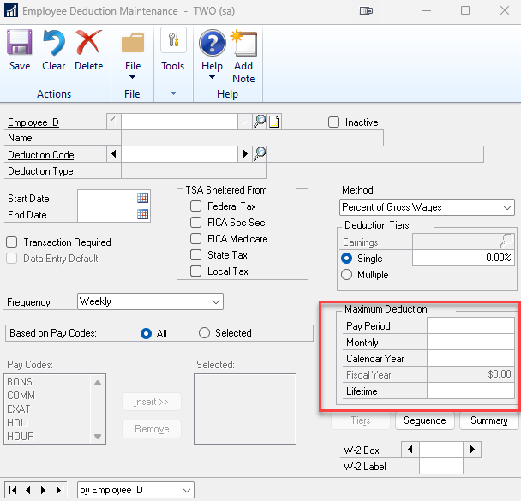
Maximum Deduction
Used to limit the total amount a deduction can take from an employee’s wages.
Ensures that deductions such as garnishments, retirement contributions, or loan repayments never exceed the defined limit.
GP will stop calculating the deduction once the maximum is reached, either for a single pay run or across year-to-date totals, depending on setup.
Notes:
The Maximum Deduction setting in Dynamics GP is used to limit the total amount a deduction can take from an employee’s wages.
This ensures that deductions such as garnishments, retirement contributions, or loan repayments never exceed the defined limit.
The system will stop calculating the deduction once the maximum is reached, either for a single pay run or across year-to-date totals, depending on setup.

Slide 14
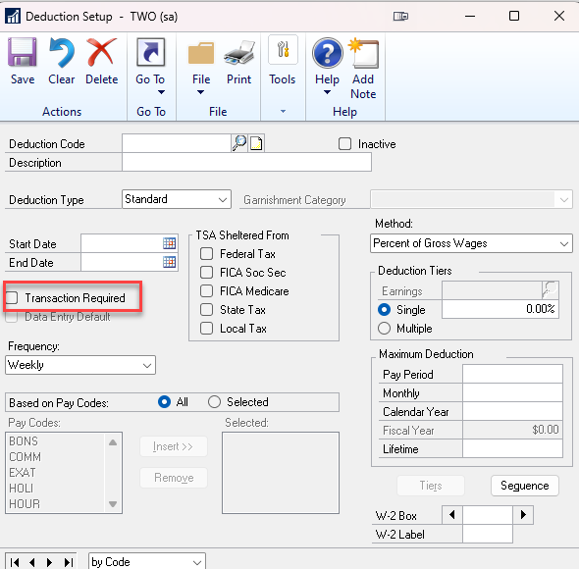
Transaction Required
When the Transaction Required is flagged, there must be a line in the transaction entry window when running payroll.
Notes:
These prior setup windows should be checked and if they are correct then we will want to look at the Transaction Required field.
When the Transaction Required is flagged then there must be a line in the transaction entry window when running payroll.

Slide 15
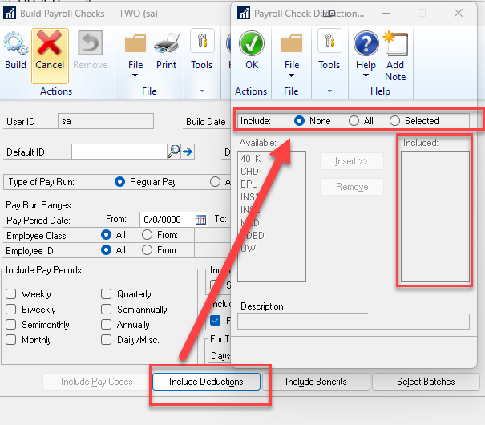
Build Batch Inclusions
Deductions, Benefits need to be added into the build setup.
Notes:
If the deduction is new, or someone new is running payroll then we will also want to check the build batch window.

Slide 16
Annualization
Because taxes are based on the annualized pay rate, employees with irregular pay patterns (bonuses, commission checks, or large overtime) may see higher or lower withholding in certain pay runs compared to steady salaries.
$1,000 weekly payroll for employee A.
Taxes are based on an annual salary of $52,000
$1,000 × 52 = $52,000
If one payroll has one bonus so their paycheck is $1,500 the taxes for that pay run will be based on an annual salary of $78,000.
$1,500 × 52 = $78,000
If the employee signs up for a 401K and the taxable wages are $800 a week then the taxes are based on an annual salary of $41,600.
$800 × 52 = $41,600
Notes:
Which leads us into Annualization. Because federal taxes use brackets, the system will use annualized pay rates to calculate taxes on a payroll.

Slide 17
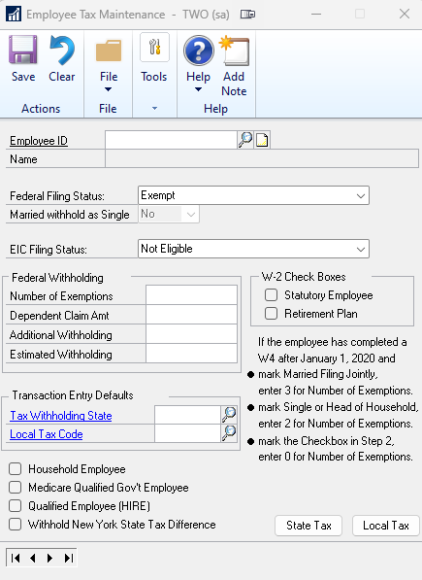
Setup Federal
Pre-Tax Deductions Impact
IRS Withholding Tables
Single vs. Multiple Pay Runs
Supplemental Wages
No Retroactive Adjustment
End-of-Year Balancing
Notes:
Pre-Tax Deductions Impact Federal taxable wages are reduced by eligible pre-tax deductions (e.g., Section 125 health premiums, 401(k) contributions) before the federal withholding calculation is applied.
IRS Withholding Tables – Dynamics GP uses the IRS Publication 15 (Circular E) tax tables to determine federal withholding.
Single vs. Multiple Pay Runs – If multiple payroll runs occur in the same period (e.g., an extra check for a bonus), the system will calculate withholding separately for each run based on the annualized value of that run’s pay.
Supplemental Wages – GP treats supplemental wages (such as bonuses) according to IRS rules. Depending on configuration, they may be taxed using the flat supplemental rate or combined with regular wages for withholding purposes.
No Retroactive Adjustment – If an employee’s tax status changes mid-year (e.g., W-4 update), GP will not retroactively adjust prior withholdings; it will apply the new calculation to future pay runs only.
End-of-Year Balancing – Because GP calculates per pay run without looking ahead at the entire year’s wages, some employees may see small over- or under-withholding amounts that reconcile when filing their annual tax return.

Slide 18
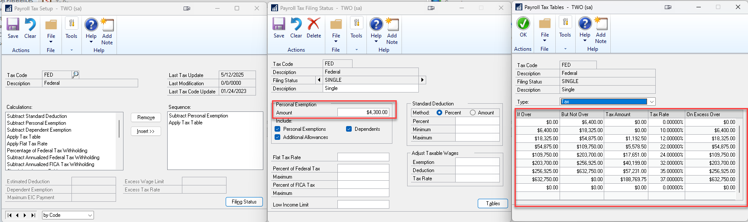
Tools
Setup
System
Payroll Tax

Slide 19
What is the System Doing?
Gross Pay
Taxable Benefits
Tax-Sheltered Annuities (TSA)
Earned-Income Credit (EIC)
Taxes
FICA Social Security
FICA Medicare
Federal taxes
State taxes
Local taxes
Sequenced Deductions
Non-sequenced Deductions
Nontaxable Benefits
Advance Paybacks
Net Pay
Notes:
Gross Pay: Microsoft Dynamics GP calculates the gross pay by summing all pay codes.
Taxable Benefits: The value of all taxable benefits is calculated, though this doesn't directly affect gross or net pay.
Tax-Sheltered Annuities (TSA): Amounts for any specified TSAs are deducted.
Earned-Income Credit (EIC): The value of any EIC payments is calculated, which affects the gross pay.
Taxes: Taxes are deducted in this order:
FICA Social Security
FICA Medicare
Federal taxes
State taxes
Local taxes
Sequenced Deductions: Amounts for sequenced deductions are deducted.
Non-sequenced Deductions: Amounts for non-sequenced deductions are deducted in alphanumeric order.
Nontaxable Benefits: Amounts for nontaxable benefits are added or deducted, which doesn't affect the gross or net pay.
Advance Paybacks: Amounts for advance paybacks are deducted.
Net Pay: The final calculated amount represents the net pay.

Slide 20
Federal Taxes Annualized Withholdings
Annualize Wages
Annualize Tax Sheltered Deductions
Subtract Exemption from Tax Table
Subtract Tax Sheltered Deductions
Calculates the gross pay by summing all pay codes.
Gross * Pay Periods = Annualized Gross
$3,000 × 26 = $78,000
Gross * Deduction Percent = Weekly Deduction
Weekly Deduction * Pay Periods
$3,000 × 6% = $180
$180 × 26 = $4,680
Locate in the tax tables per the employee’s setup.
Ex. Filing as Single with no additional withholdings
$78,000 - $4,300= $73,700
Annualized Wages & Exemption
- All Annualized Deductions
= Taxable Wages
$73,700 - $4,680 = $69,020
Taxable Wages = $69,020
Reference: https://mskb.pkisolutions.com/kb/855655
Notes:
Annualize Wages: Calculates the gross pay by summing all pay codes.
Taxable Benefits is calculated (doesn't directly affect gross or net pay).
Gross * Pay Periods = Annualized Gross
Annualize Tax Sheltered Deductions
Pay * Deduction Percent = Weekly Deduction
Weekly Deduction × Pay Periods
Subtract Exemption from Tax Table
Locate in the tax tables per the employee’s setup.
My example will use Filing as Single with no additional withholdings.
Subtract Tax Sheltered Deductions
Annualized Wages & Exemption - All Annualized Deductions= Taxable wages

Slide 21
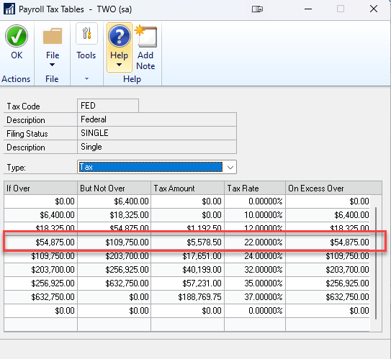
Federal Tax Calculation Continued
Gross Wages
Taxable Wages = $69,020
This places the tax bracket at 22% (Single)
Base Tax Amount
Base Tax Amount = $5,578.50
From the IRS table row that covers taxable income bracket where $58,608.14 falls.
The IRS table says: “If wages exceed $X but not over $Y → Withholding = $Z plus % of excess over $X.”
Excess Over Threshold
This is $54,875 for the Gross Wages of $69,020
Gross Pay – Excess Over Threshold = Excess Amount
$69,020 - $54,875 = $14,145
Threshold Amount
Excess Amount * Bracket Percent = Threshold Amount
$14,145 × 22% = $3,111.90
Threshold Amount + Base Tax Amount = Annual Tax
$3,111.90 + $5,578.50 = $8,690.40
Divide by 26 pay periods = $334.25 per check
Final Tax

Slide 22
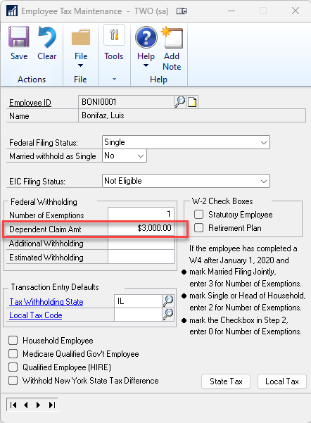
Dependent Claim Amount
Dependent Claim Amount divided by the pay frequency $3,000 / 26 pay periods = $115.38
Subtract that result from the federal tax you calculated for the pay run. $334.25 - $115.38 = $218.87

Slide 23
FICA Social Security
Gross Pay Calculation
Dynamics GP first calculates the employee's gross pay based on their pay codes.
Taxable Wages
This is pulled from the Employee Benefit Card. If they are subjected to FICA then the FICA Soc Sec or FICA Medicare will be checked.
Using our example: $78,000
Applying FICA Rates
Social Security: A fixed rate of 6.2% up to the annual Social Security wage limit, which is $176,100 for 2025.
Medicare: A fixed rate of 1.45% is applied to all taxable wages, as there is no wage limit for Medicare taxes.
Additional Medicare Tax: For individuals exceeding certain income thresholds ($200,000 for single filers, $250,000 for married filing jointly, etc.), an additional 0.9% Medicare tax is applied to the income above those thresholds.

Slide 24
FICA Calculations
Social Security
Medicare
Gross Wages
Taxable Wages = $78,000
2025 Question
Is income less than $176,100?
If no then take full amount.
If yes then take up to $176,100.
Calculate Annual Withholding
$78,000 × 0.062 = $4,836.00
Calculate Per Pay
$4836.00 / 26 = $186
Gross Wages
Taxable Wages = $78,000
2025 Question
No wage cap at this level (the additional 0.9% surtax only applies if wages exceed $200,000 for single filers).
Calculate Annual Withholding (Employee Portion)
$78,000 × 0.0145 = $1,131
Calculate Per Pay
$1,131/ 26 = $43.50

Slide 25
Prevention Reports
Payroll Posting Accounts Report
Verifies that wage, tax, deduction, and benefit posting accounts are assigned correctly.
Helps identify missing GL accounts that would otherwise cause posting failures.
Deduction & Benefit Setup Reports
Confirm calculation methods, limits, and tax flags are configured as intended.
Pay Code Setup Report
Ensures pay types (regular, overtime, bonus, salary) are correctly assigned and linked to proper tax rules.
Tax Setup / Employee State Tax Report
Verifies federal, state, and local tax codes are assigned correctly.
Confirms employees are linked to valid filing statuses and exemptions.

Slide 26
During Pay Runs (Validation Reports)
Preliminary Payroll Register
Shows gross-to-net calculation for each employee before checks are generated.
Best for spotting unusual deductions, incorrect tax withholding, or misapplied benefits.
Build Check Report
Summarizes the employees and pay runs included in the payroll batch.
Lists gross wages, deductions, taxes, and net pay totals.
Best to locate employees accidentally excluded from payroll, Unexpected totals (e.g., tax totals out of line with previous runs), and batch-level discrepancies before posting
Calculation Report
After you click Build Checks and the system calculates gross-to-net for each employee.
Shows the detailed calculation of wages, taxes, deductions, and benefits for each employee in the batch.
Helps verify that federal, state, and local taxes are withholding as expected.
Best for finding over/under withholding of federal taxes, incorrect deduction amounts, misapplied pay codes (e.g., overtime taxed wrong)

Slide 27
Payroll Issue Resolution
Detect
Diagnose
Validate
Decide Fix Path
Apply Fix
Document/Prevent
Notes:
Detect: Capture symptoms, scope (single employee vs. entire run), and impact (tax/GL/compliance).
Diagnose: Pull source evidence (batch reports, employee card, pay codes, tax setups, posting accounts).
Decide Fix Path: Void/reissue vs. manual check vs. historical edit vs. FUTA/SUTA history edit vs. GL reclass only.
Apply Fix: Execute in a copy of company/test first when feasible; then production with controls.
Validate: Re-run proofs (gross-to-net, 941/ERC sections, SUTA wages, GL distributions).
Document/Prevent: Log what changed, why, and add a preventive control.

Slide 28
Direct Deposit Issue
Correct setup
Re-create ACH
Verify bank totals
Void stray checks if needed
Document
Check prenote status/employee DD active flag
Bank file path/permissions
DD setup per checkbook
Batch origin

Slide 29
Wages missing from 941
Verify pay code type/tax box mapping
Confirm deduction taxability
Check frequencies used for calculation vs. timing
Correct Mapping
Recalc or Adjust History
Re-run 941 and Proofs
Document
Notes:
Wages missing from 941 / mapped incorrectly
Is this missing a screenshot?

Slide 30
Benefits/Deductions miscalculating
Review:
Method (percent/amount)
Limits
Taxability
Arrears
Frequency
Fix Setup
Test with a Sample Check
Apply Adjustments via Manual Check if Needed
Validate YTDs

Slide 31
Posting to wrong GL accounts
Trace account from:
Payroll Posting Setup
Pay Code / Deduction Overrides
Employee Overrides
If history is correct: GL reclass only
If history is incorrect: fix setup and reissue. Reconcile and document.
Notes:
I have a separate webinar for understanding pay codes. Linked in the Reference links

Slide 32
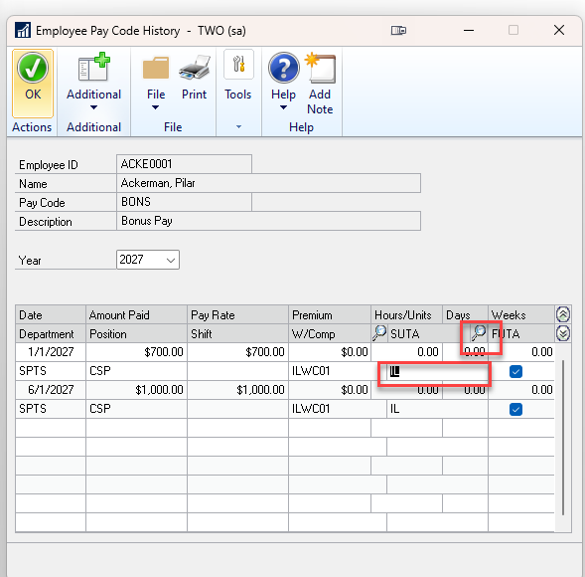
Wrong SUTA/FUTA wages or rate
Confirm state assignment, SUTA rate/effective date, multi-state employees.
Enable Financial Field Editing HR & Payroll > Setup > Payroll > Options Check "Edit Financial Fields" to allow historical edits.
Locate the Paycode Cards > Payroll > Paycodes Pull up the specific pay code in question.
Edit the History Click the History button on the paycode card. Expand the details and edit the SUTA state on the 2nd row of the detail for each record.
Notes:
Confirm state assignment, SUTA rate/effective date, multi-state employees.
Edit history where allowed; correct setup; regenerate quarter reports; reconcile to GL.
Confirm state assignment, SUTA rate/effective date, multi-state employees.
Enable Financial Field Editing: Go to HR & Payroll > Setup > Payroll > Options and check the box for "Edit Financial Fields" to allow historical edits.
Locate the Paycode: Go to Cards > Payroll > Paycodes, pull up the specific paycode in question.
Edit the History: Click the History button on the paycode card. You can then expand the details and edit the SUTA state on the 2nd row of the detail for each record.

Slide 33
Is a Check Wrong?
Choose between supplemental run vs. manual check with proper tax treatment.
Check Run
Void & reissue
Manual Check
You cannot have corrections in a batch and remove the batch. This will cause an error.
Validate taxes, benefits, leave accrual effects; document rationale.
Do not add corrections to a batch for manual checks.
Notes:
Void & reissue if possible; else manual check with offsets.

Slide 34
Summary Points
Start with setup: After you identify the error, pick one employee and open the setup windows first.
Controls: Pre-run checklist; two-person review for bank files; quarterly tax audit; change management.
Monitoring: Exception reports (zero tax, negative net, mismatched GL); alerts on rate or setup changes.
Notes:
Start with setup (anchor message):
“Every fix begins by confirming configuration.
Once we spot an error, we select one affected employee and review the core setup windows
—Pay Codes, Deductions/Benefits, Tax, Posting Accounts, and any Employee-level overrides.
If setup is wrong, history fixes won’t stick.”
Controls: “We prevent repeats with simple controls: a pre-run checklist, a second set of eyes on bank files, quarterly tax audits, and formal change management for any setup edits.”
Monitoring: “We watch for issues that slip through: exception reports for zero tax, negative net, or GL mismatches, plus alerts whenever rates or setup values change.”

Slide 35
Reference Links
https://learn.microsoft.com/en-us/troubleshoot/dynamics/gp/incorrect-calculations-on-payroll-report
https://community.dynamics.com/blogs/post/?postid=f65a8b3b-ef87-432c-a3c4-80ed7077a79d
W4 Reference: https://community.dynamics.com/blogs/post/?postid=e8191175-06ea-4862-aade-dc68fff0bdf1
Pay check city Paycheck Calculator: www.paycheckcity.com/calculator/netpay/us/alabama/calculator.html
Integrity Data 3rd Party Add on: Gross-Up Payroll Calculator & Paycheck “What If”

Slide 37
DYNAMICS GP
© 2025 Dynamic Communities. All rights reserved.

